Slide 1
Feature Extraction and Price Prediction for Mobile Phones
By: Garima Mahajan

Slide 2
Project Overview
Data cleaning and preprocessing was performed on Dataset.
The different methods employed for data wrangling were:
- Filling the null values in column
- Dropping out unnecessary columns
- Checked the datatypes, summary and dimensions of the dataset, treated the missing values
Identified the outliers and checked the skewness, correlation of the data.
Box-plots were constructed for visualising the data after treating the outliers
Heatmap was constructed to visualize the correlation of the data
Different EDA plots were plotted to check the important features using Groupby function
New features were developed using Feature Engineering

Slide 3
Methodology
Libraries used:
Pandas: Data manipulation library that provides data structures like DataFrames for easy handling and analysis of structured data.
NumPy: Fundamental library for numerical computing in Python, offering powerful array objects and mathematical functions for array operations.
Matplotlib: Comprehensive plotting library for creating static, interactive, and publication-quality visualizations in Python.
Seaborn: Statistical data visualization library that works well with Pandas and Matplotlib, offering high-level functions for creating informative statistical plots.
StandardScaler: Was used to standardizes features by removing the mean and scaling to unit variance
The code was executed in Google Colab notebook.

Slide 4
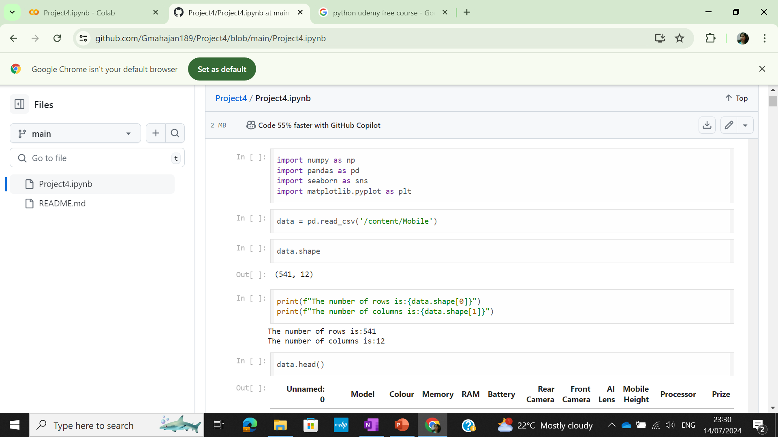
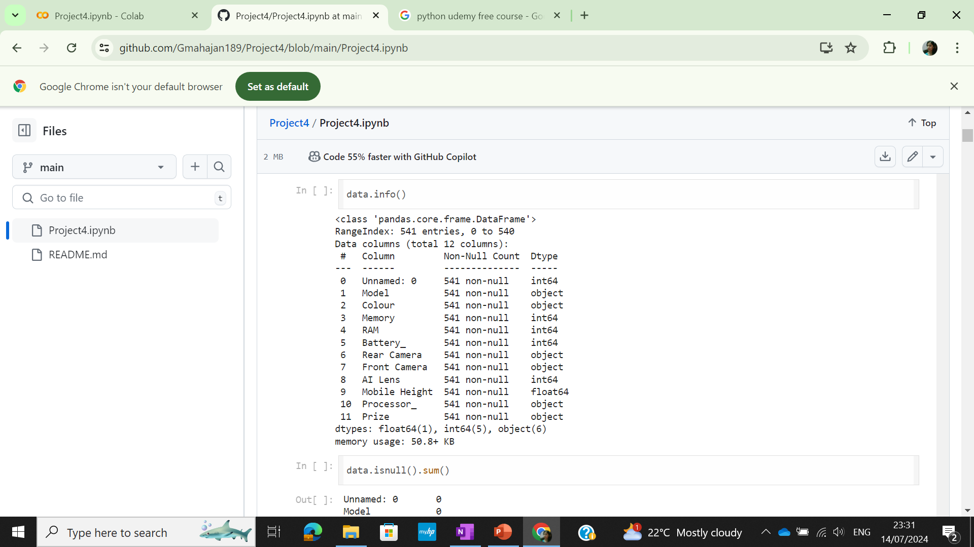
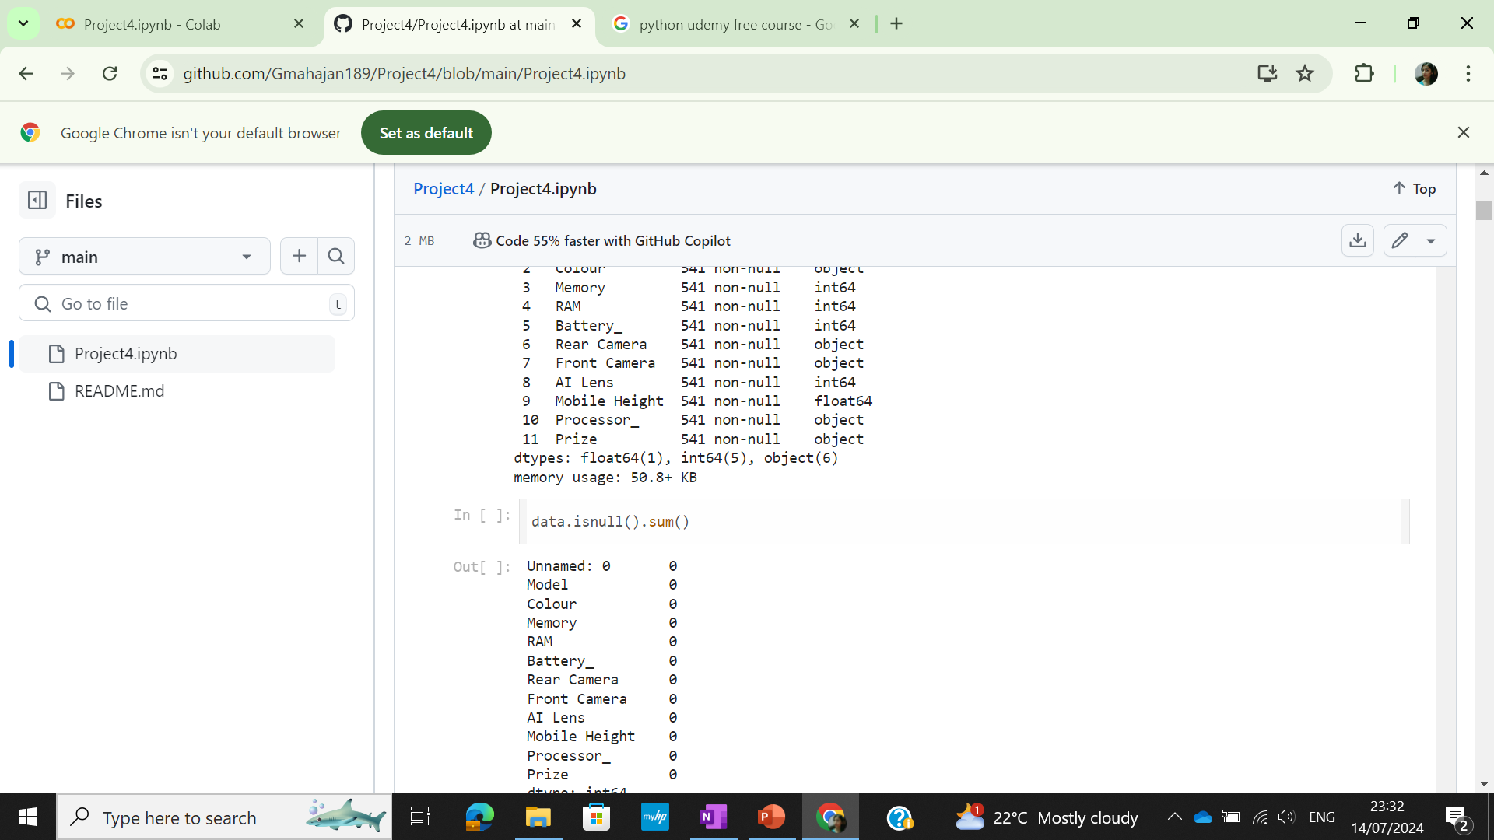
Solution
Importing the libraries
To read the csv file
To check dimension of the dataset
To check the first 5 rows
To check the data info
To get data null values

Slide 5
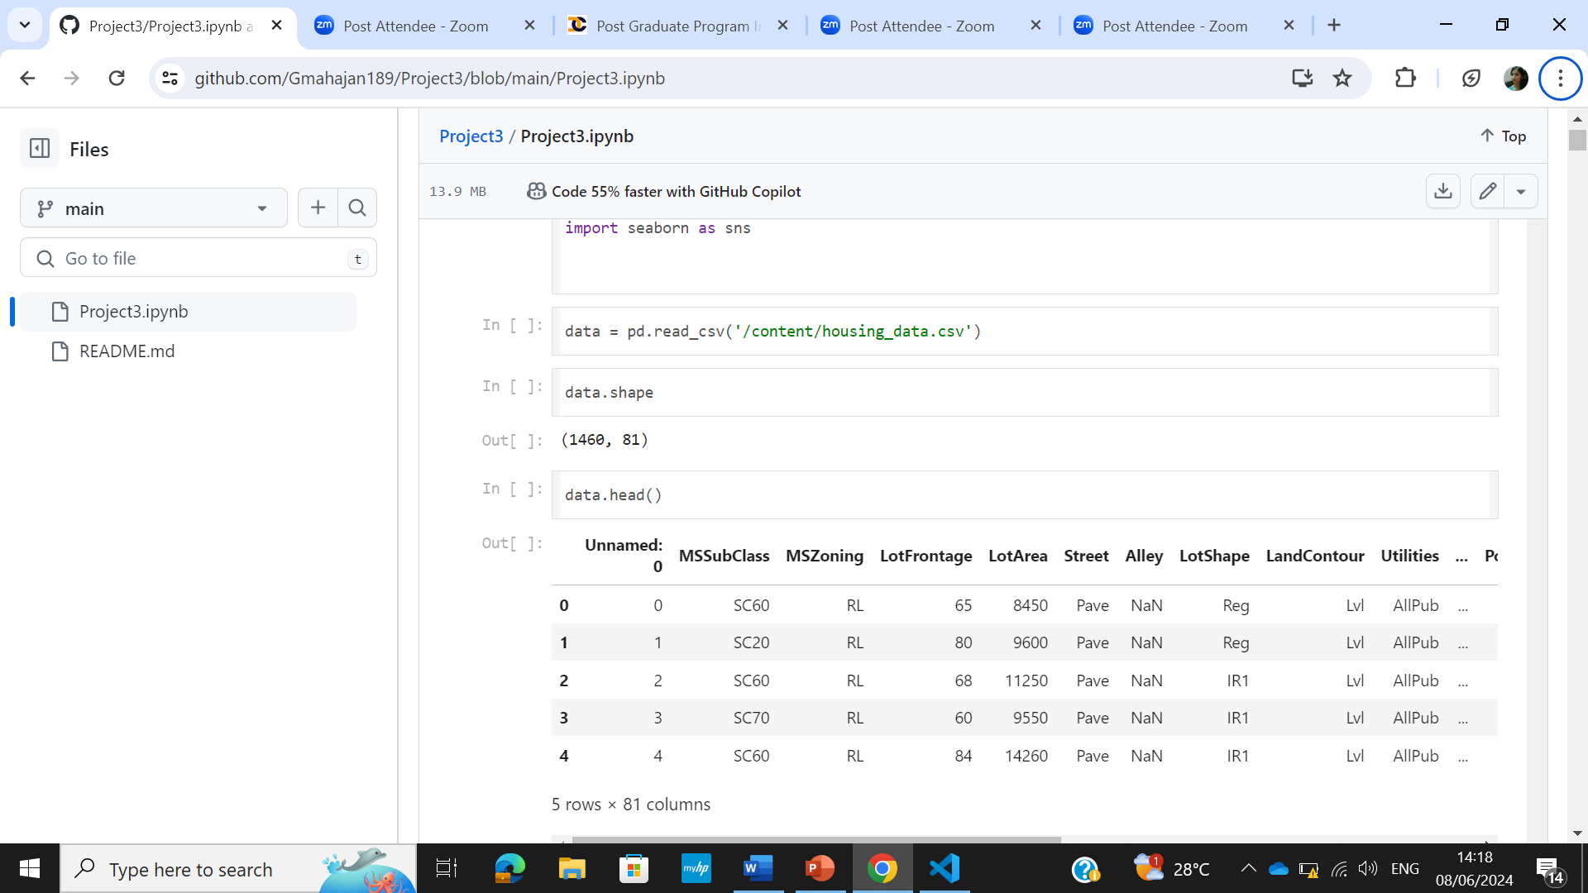
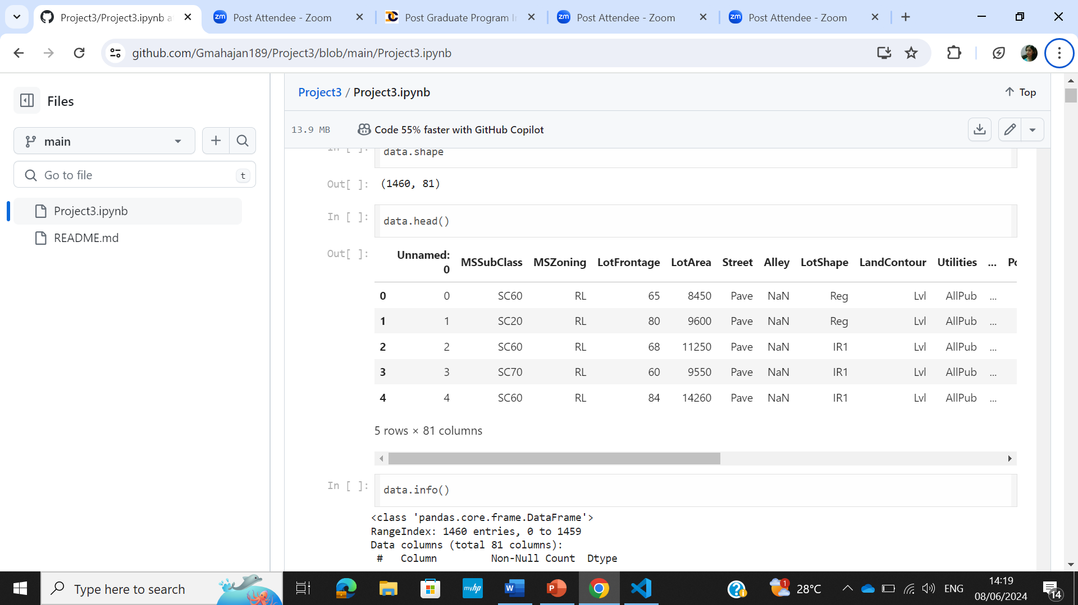
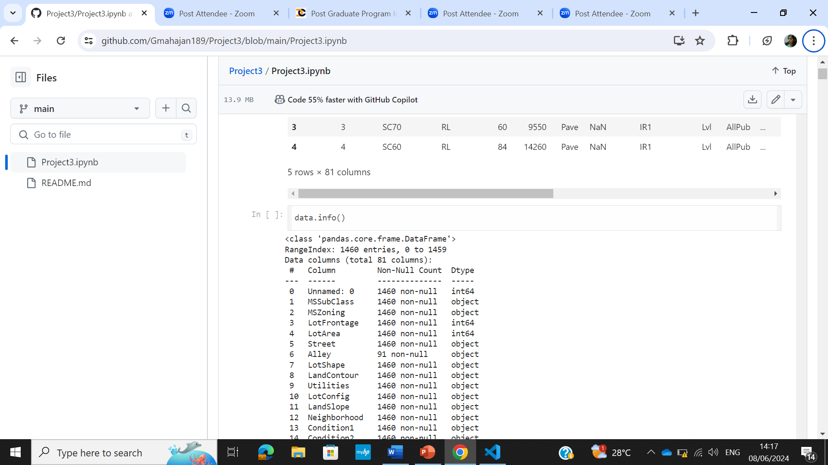
Solution
To read the excel file into pandas dataframe
To see the top 5 entries in the dataset
For the dataset information

Slide 6
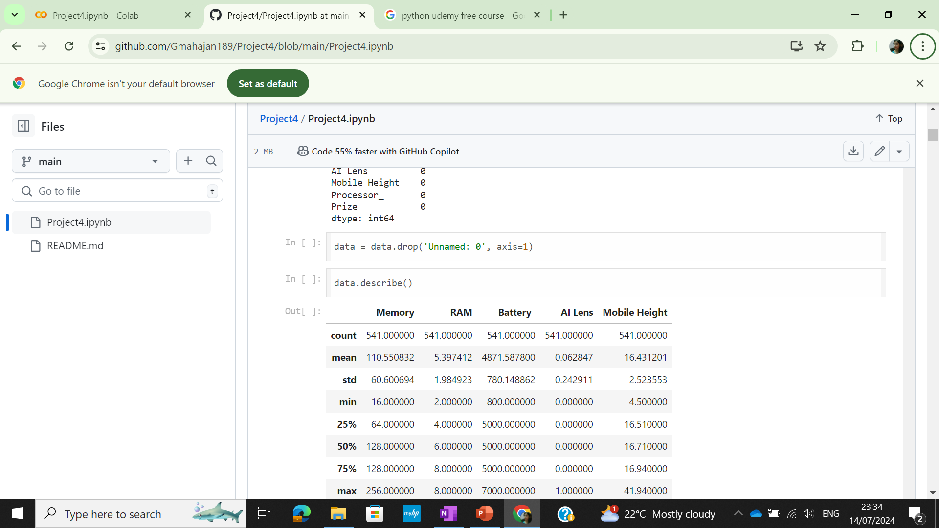
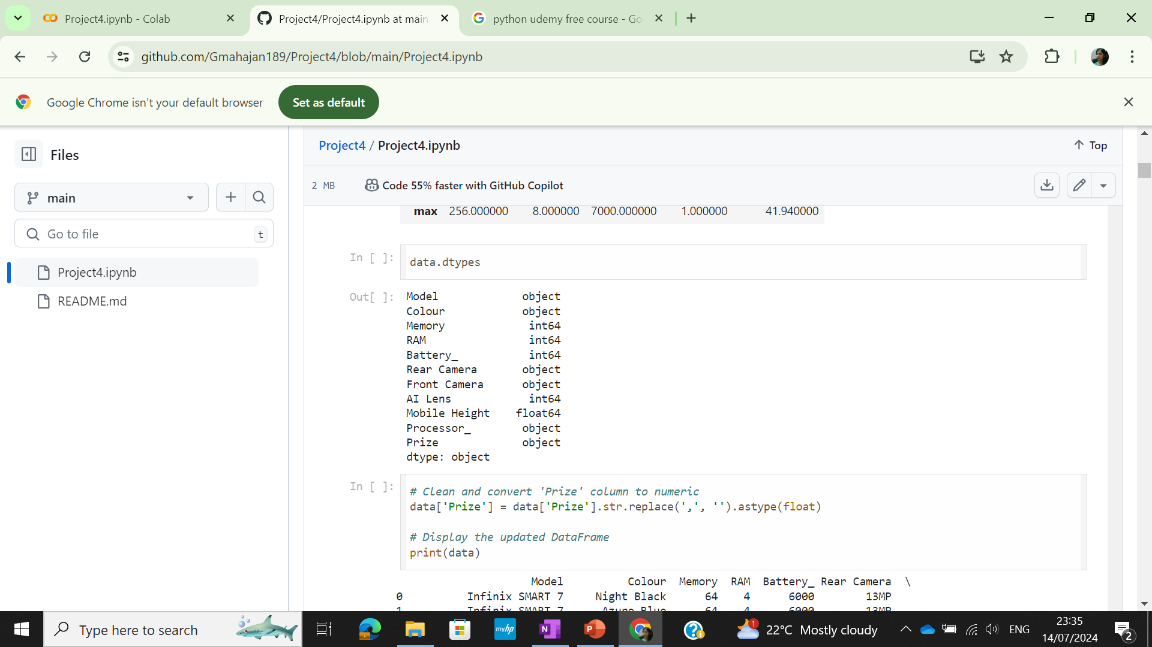
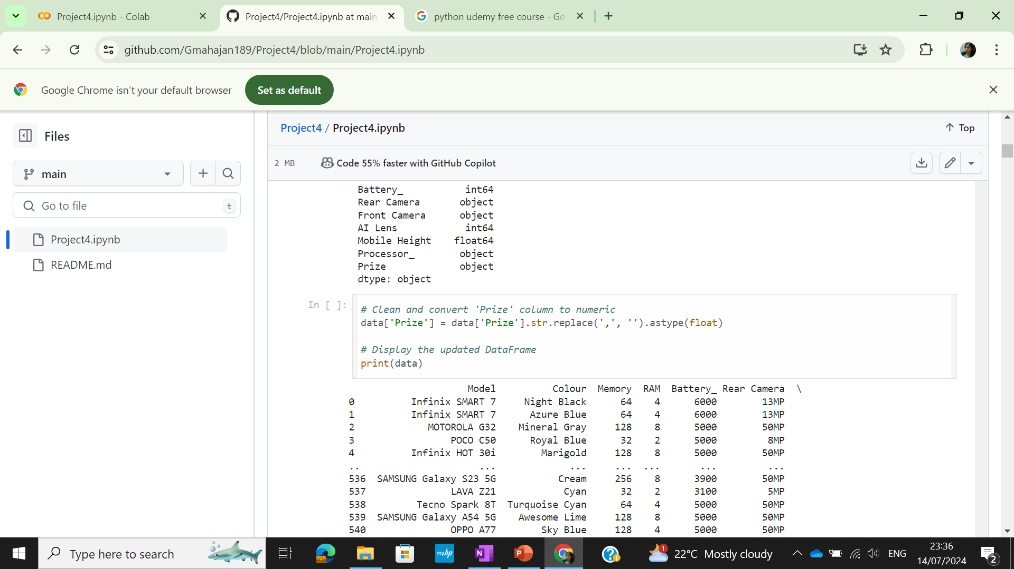
Solution
To drop the column
To convert prize column from object to float(numeric)
To check the datatypes of the dataset

Slide 7
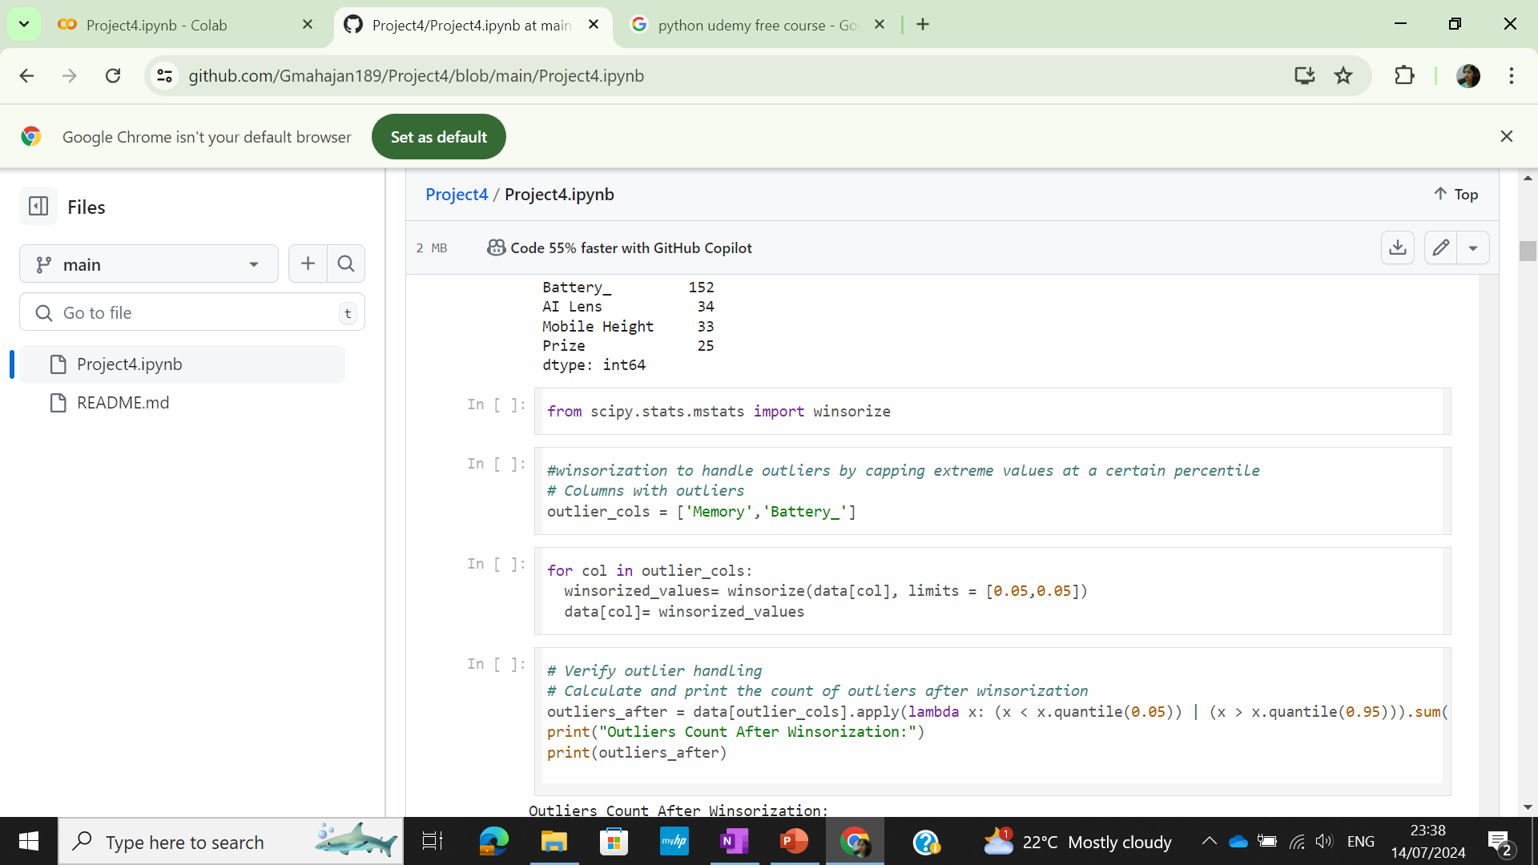
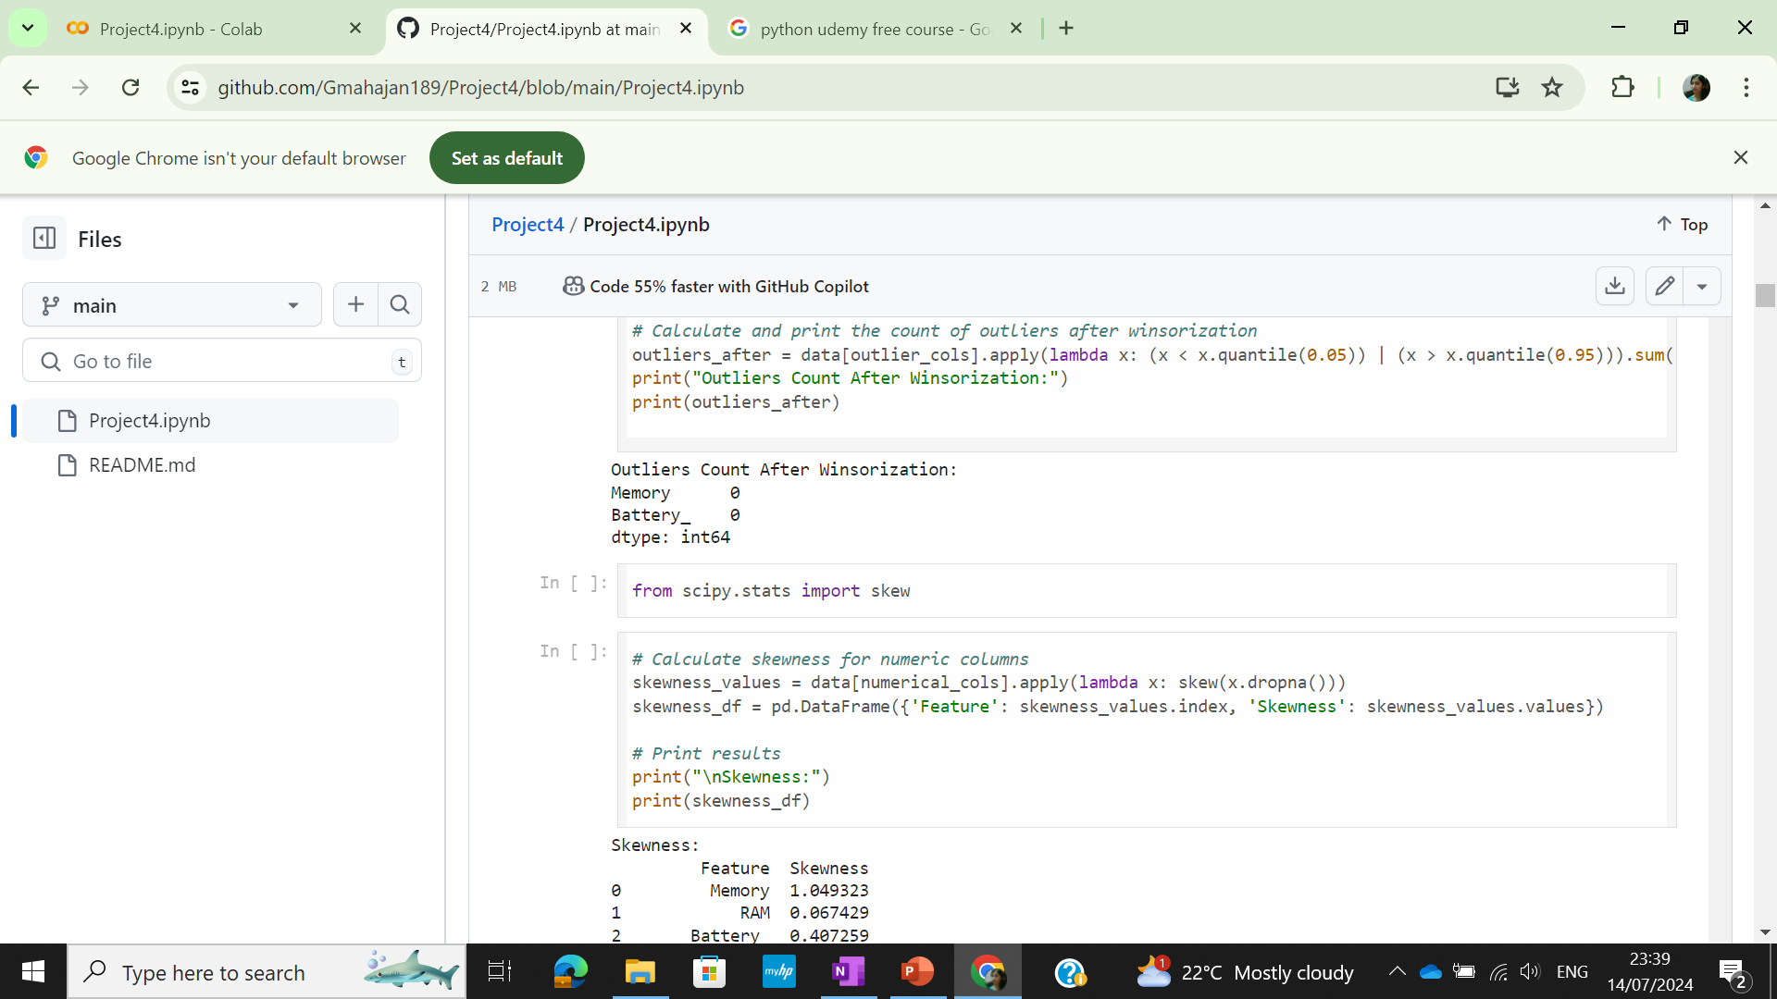
Solution
Winsorization was used to handle outliers
Skewness of the data was checked

Slide 8
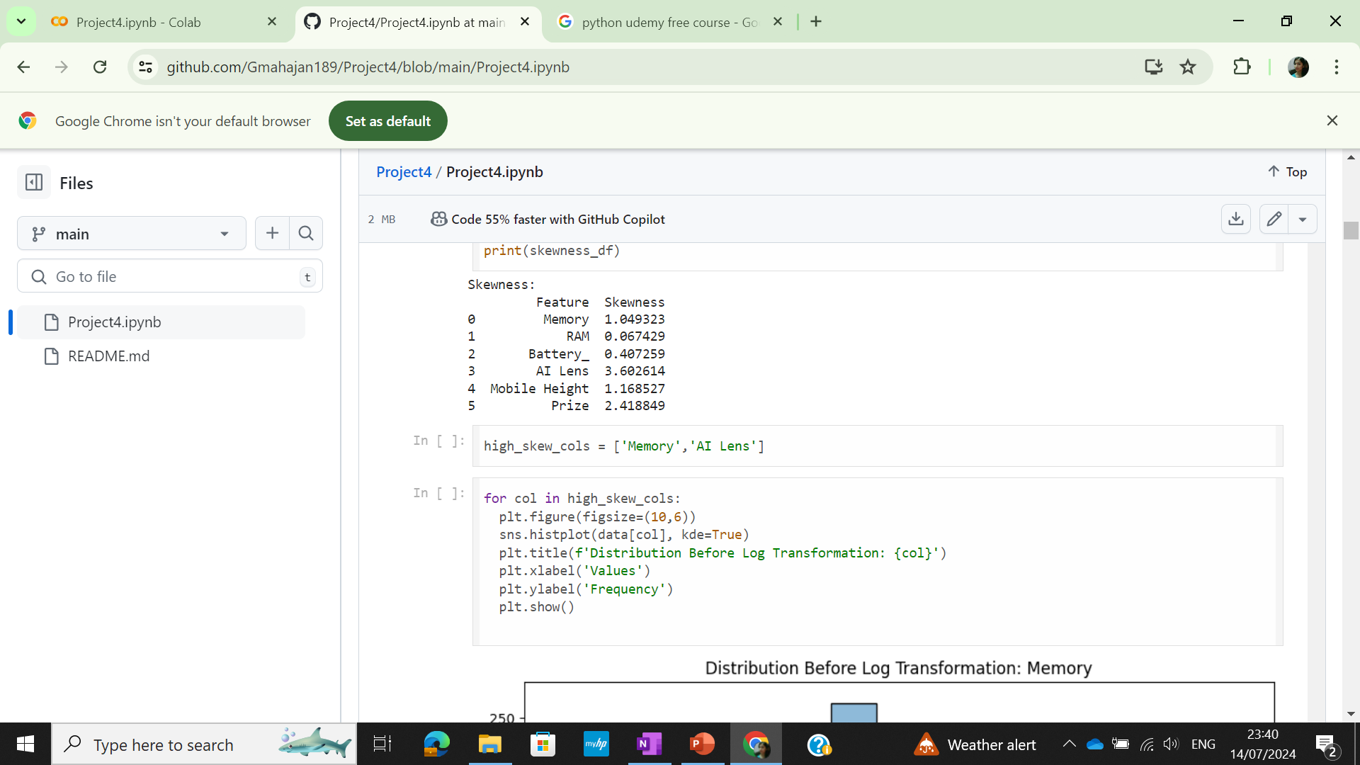
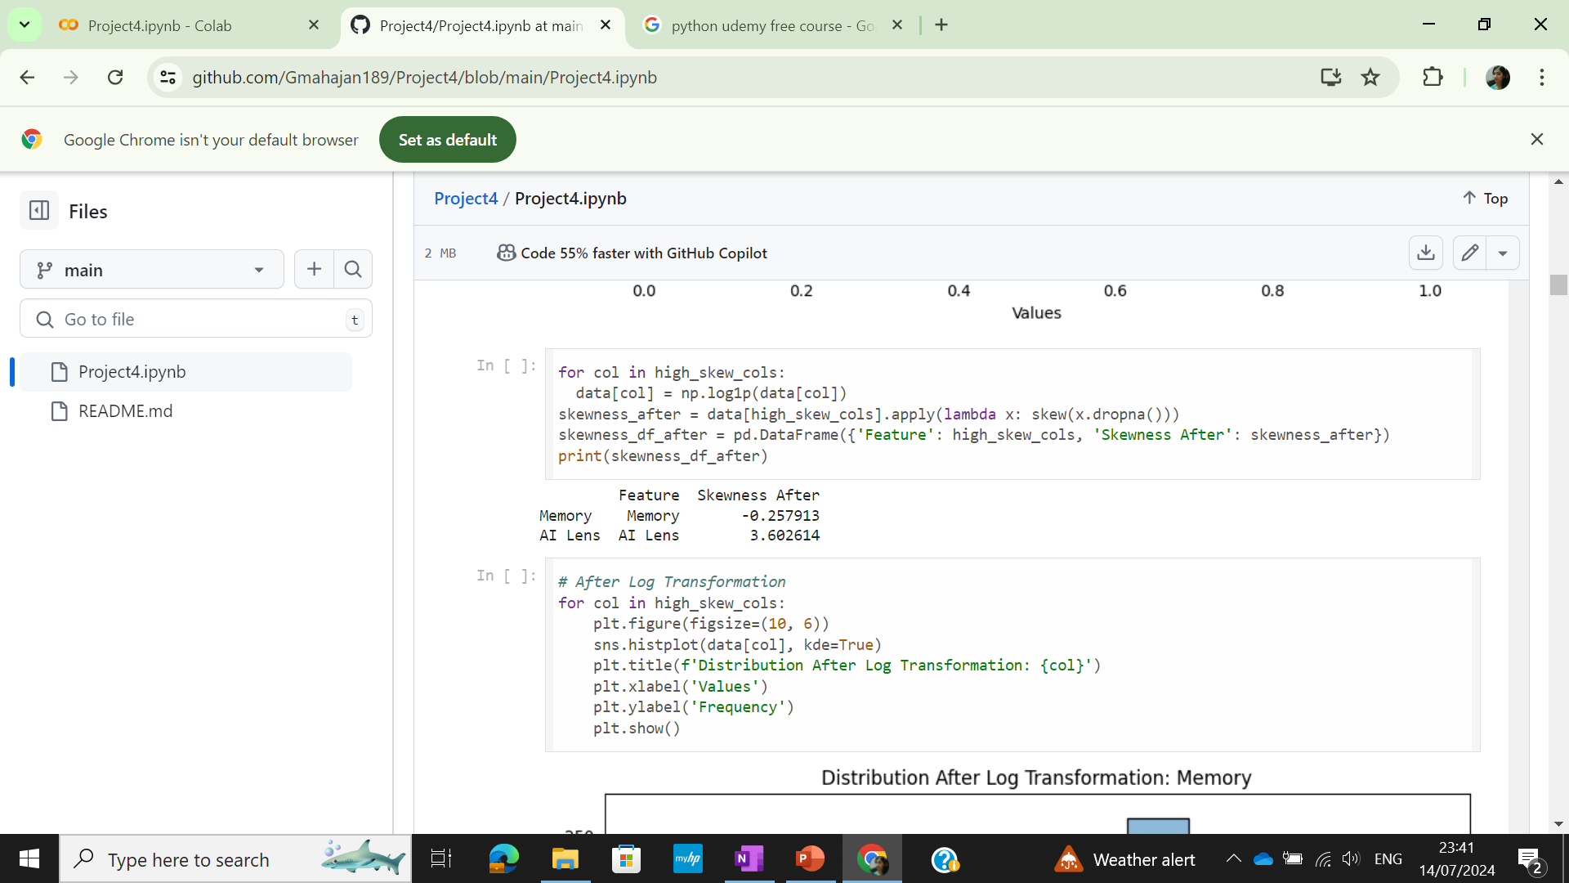
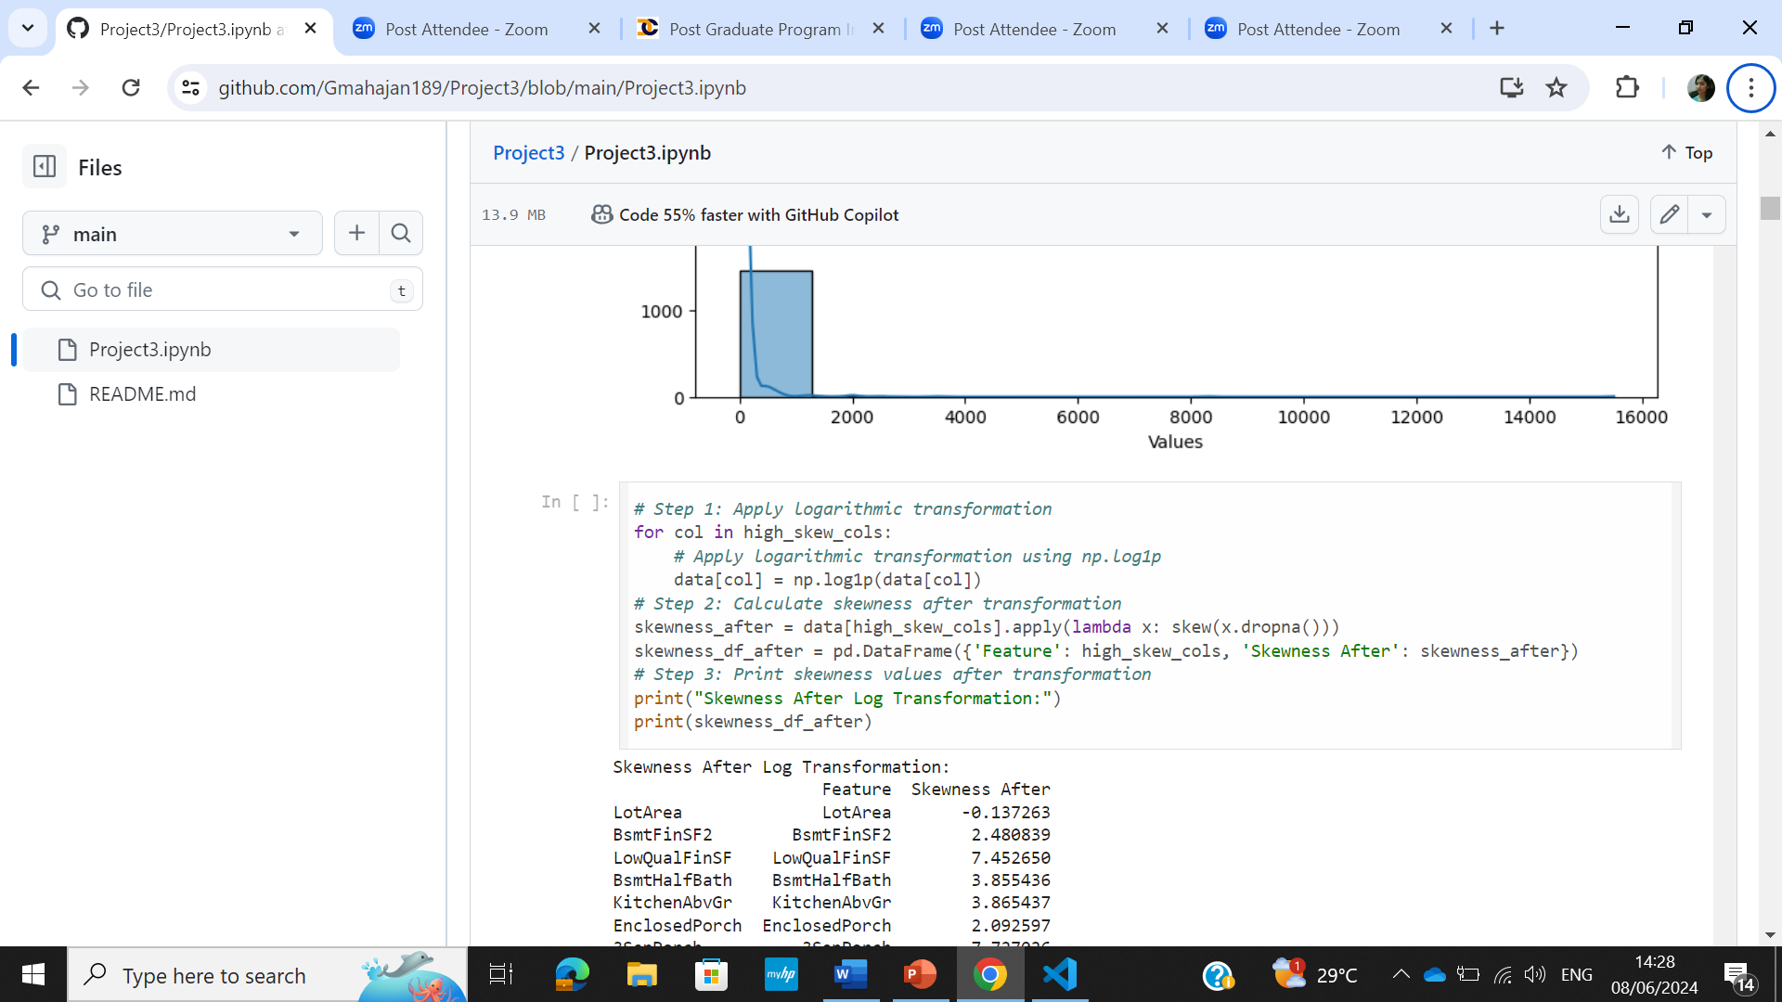
Solution
To check the distribution before transformation using histogram
The high skew columns were normalized using logarithmic transformation

Slide 9
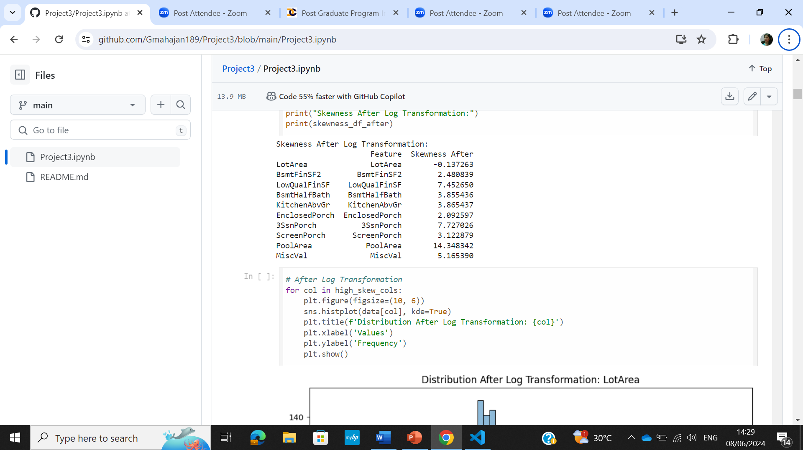
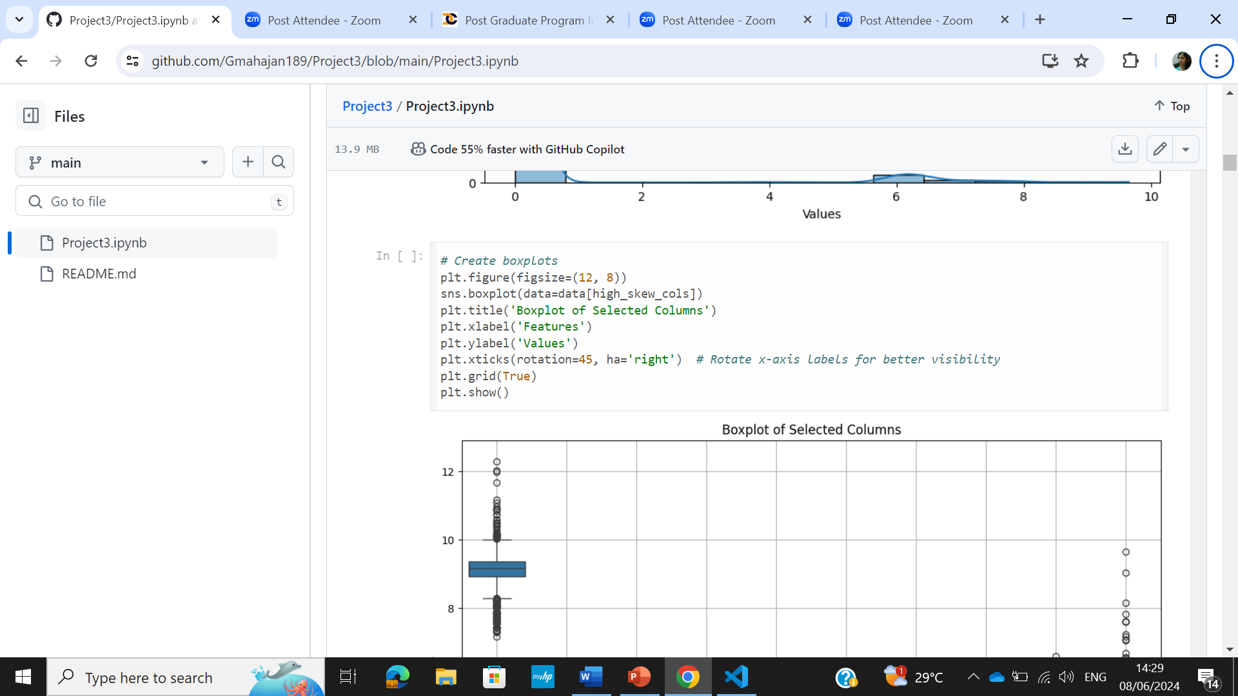
Solution
After logarithmic transformation skewness was checked and distribution was plotted
To construct the box-plot for the selected columns

Slide 10
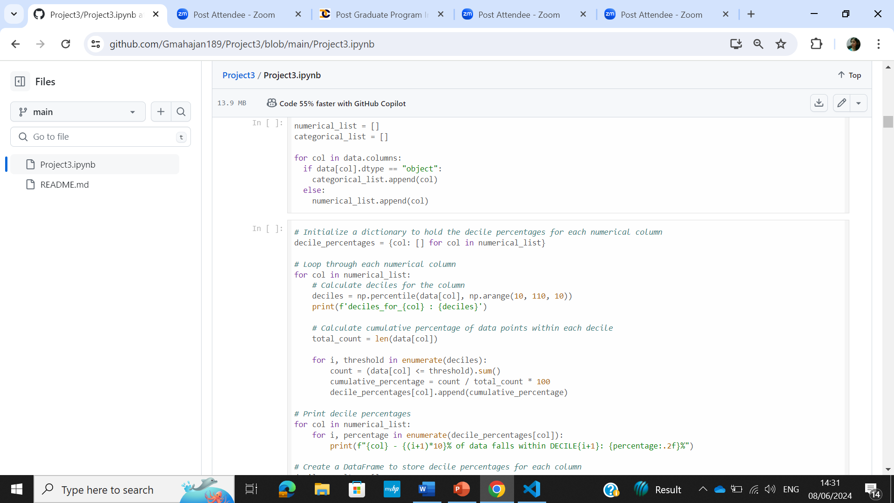
Solution
Numerical and Categorical list was made
The decile percentages for each column were calculalated to know how the data is distributed within every decile

Slide 11
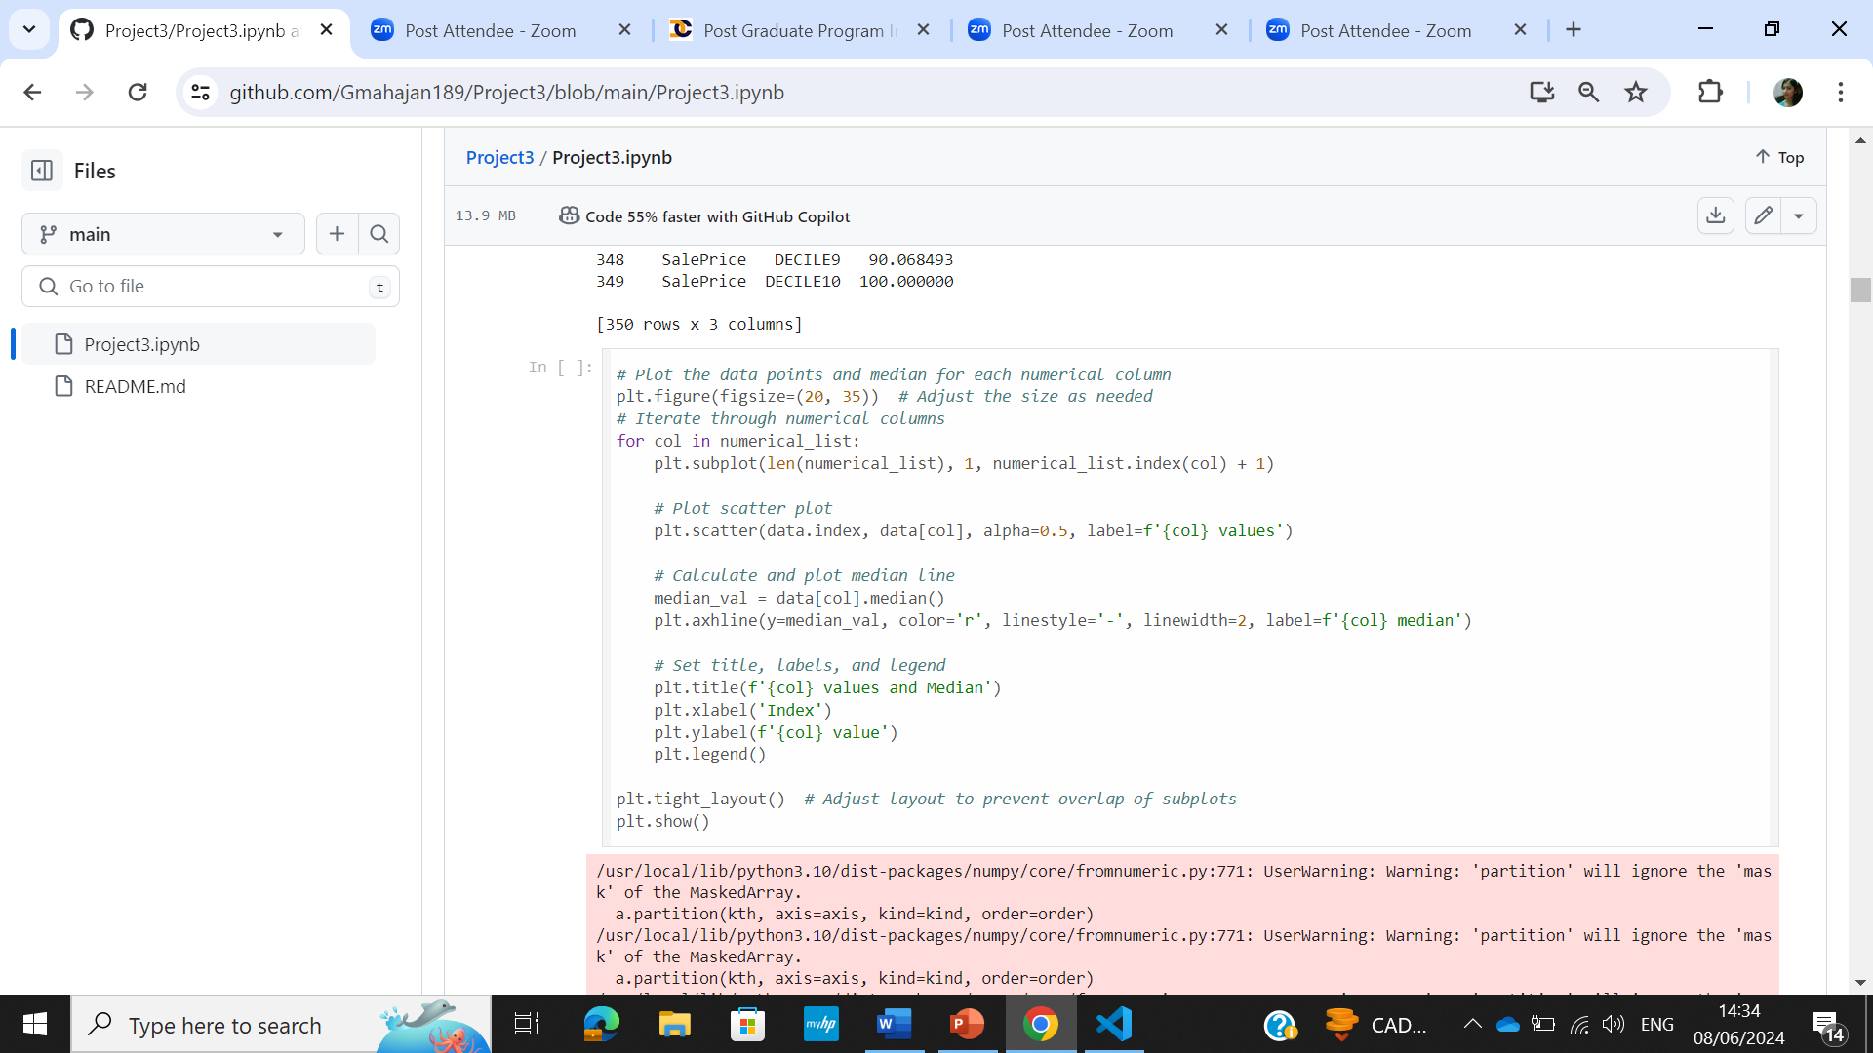
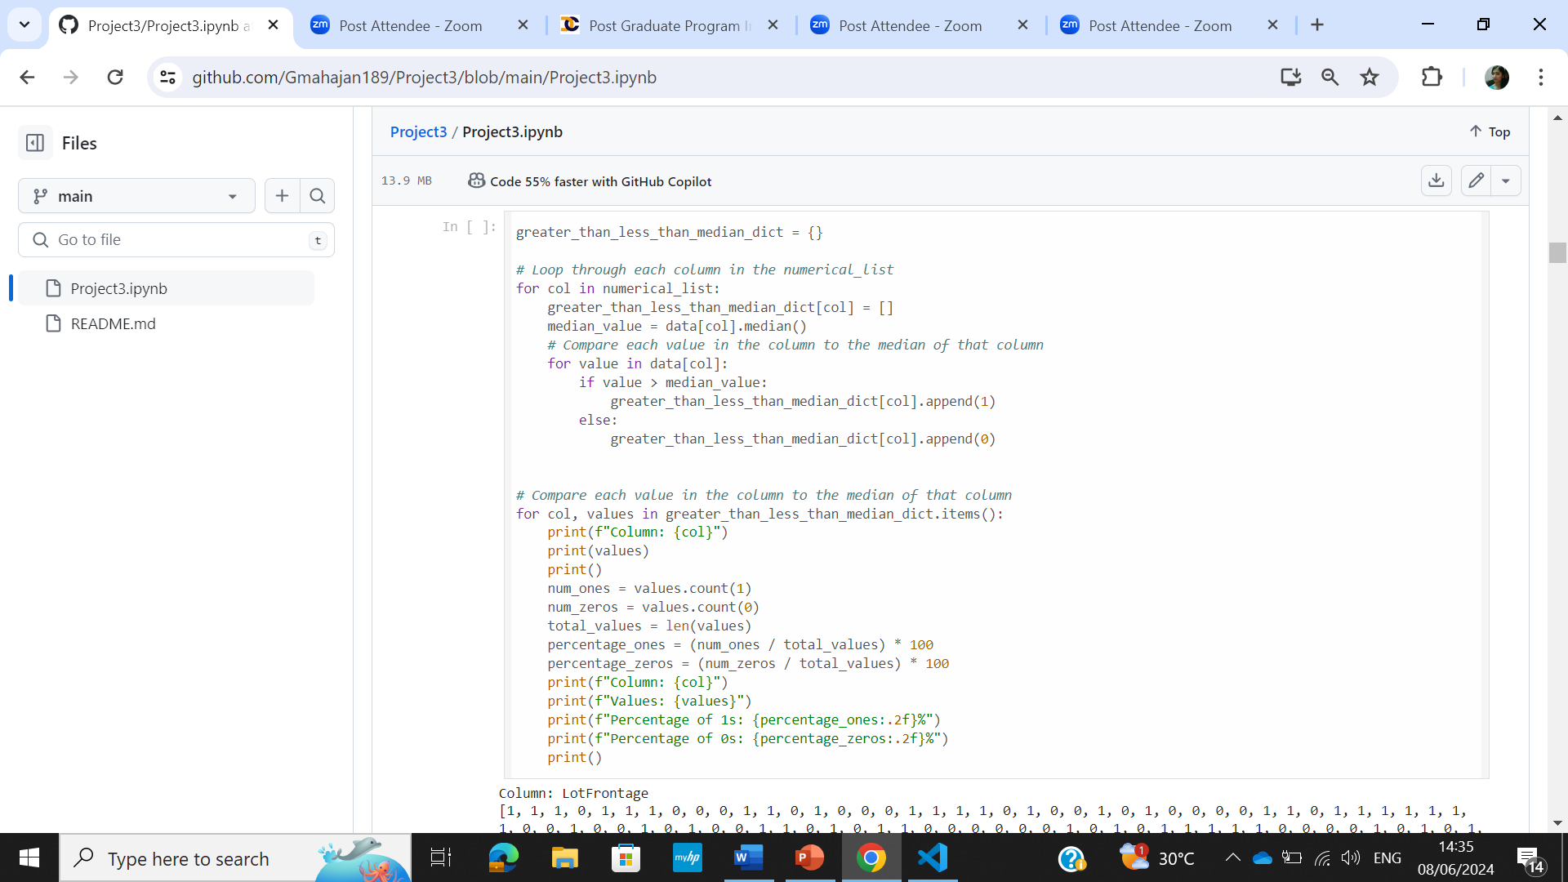
Solution
Data distribution for each column along the median was plotted using scatter plot
Dictionary was made and the percentage data greater than,less than median was stored

Slide 12
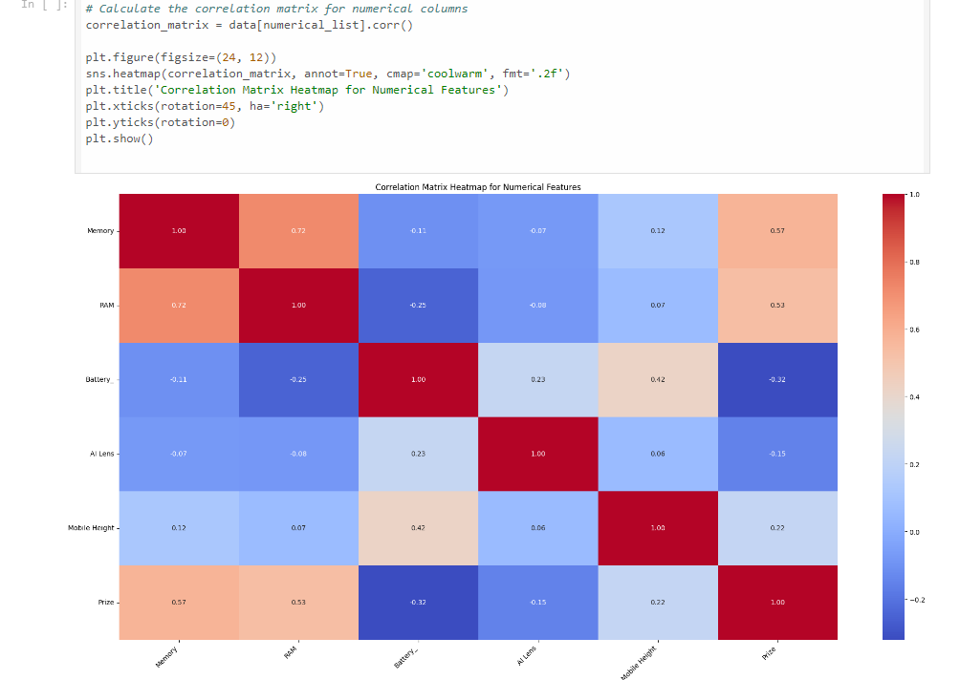
Solution
To calculate the correlation matrix for the selected columns and create heatmap to visualize the correlation

Slide 13
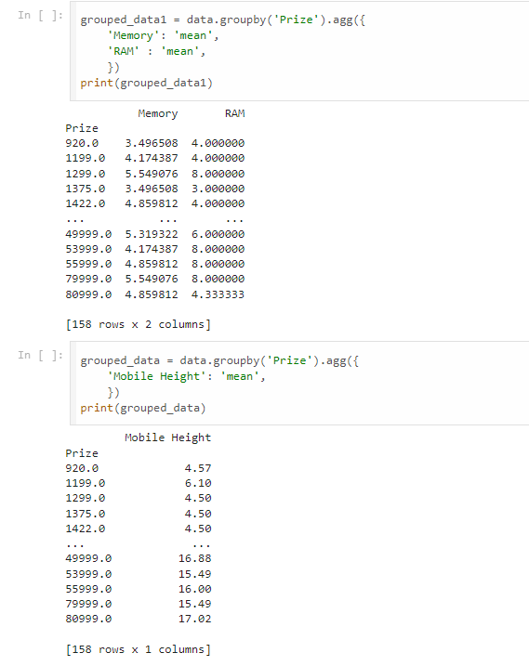
Solution
Data was grouped using Groupby on ‘Prize’ and aggregated on Memory,RAM mean
Data was grouped using Groupby on ‘Prize’ and aggregated on Mobile Height mean

Slide 14
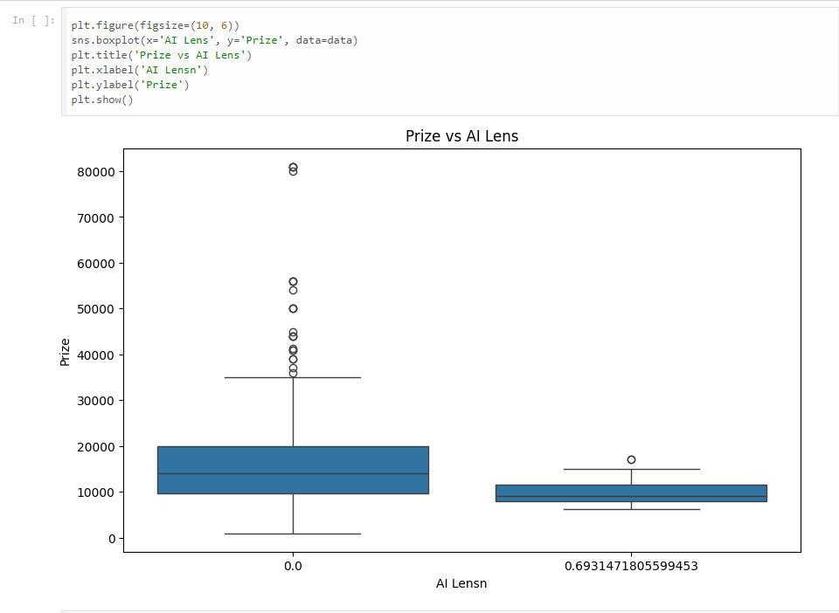
Solution
Boxplot was made for Prize vs AI Lens
AI Lens 0.0 indicated a wider prize range compared to he other one

Slide 15
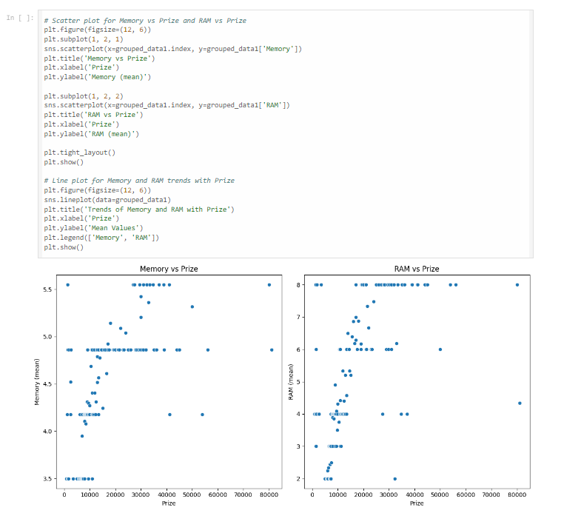
Solution
Scatterplot was made between Memory and Prize, Memory and RAM
To visualize the relationship between the variables

Slide 16
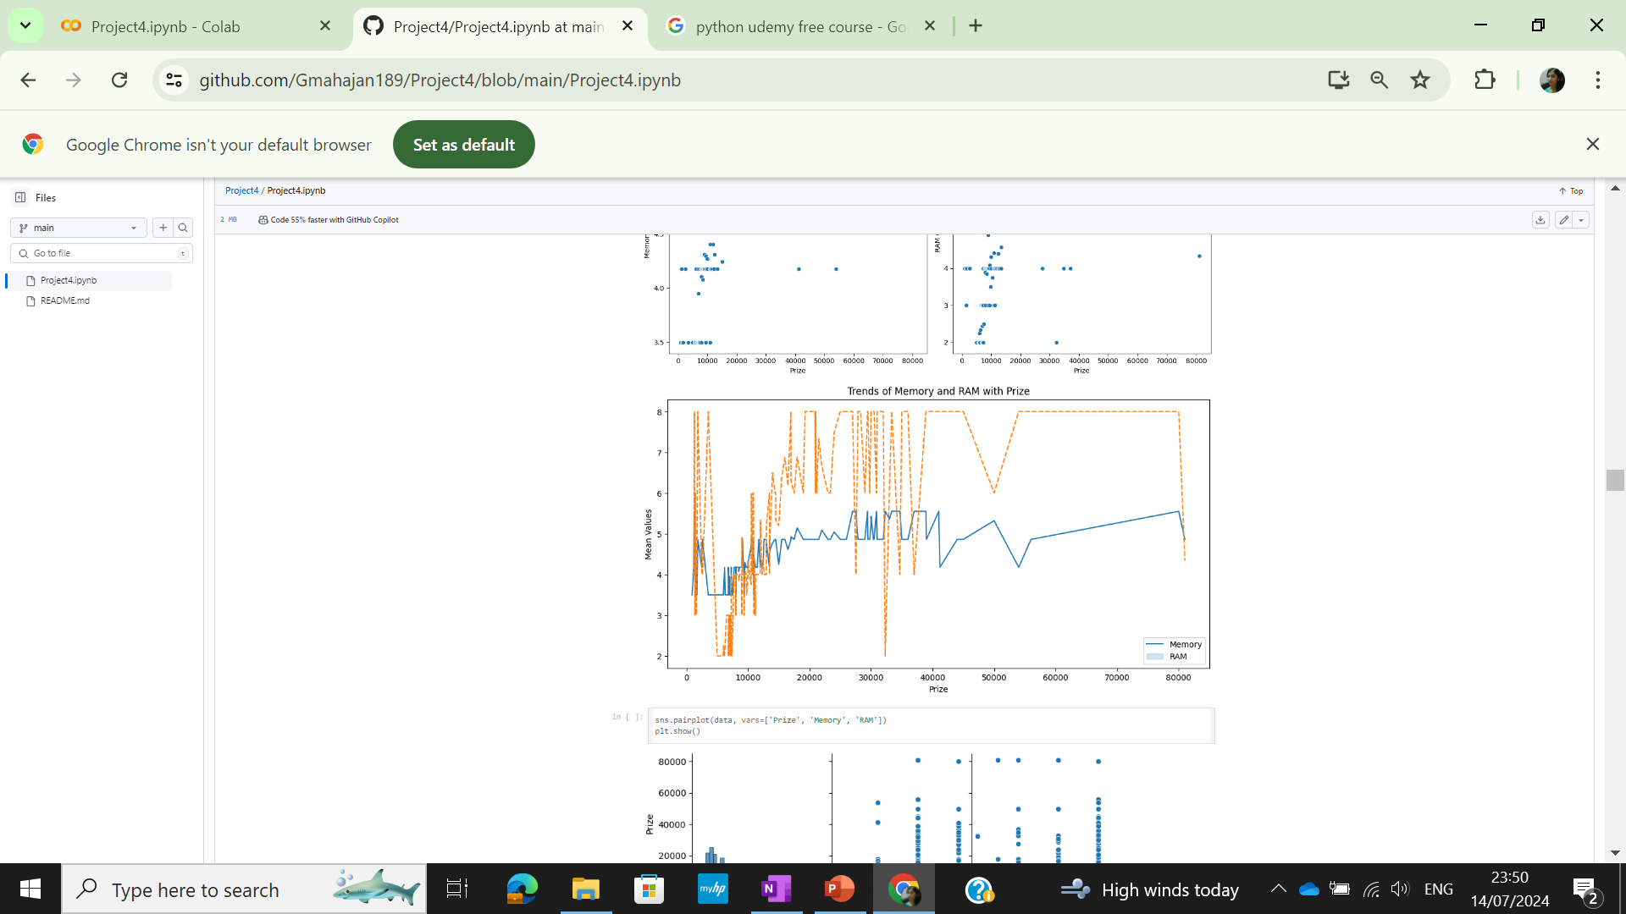
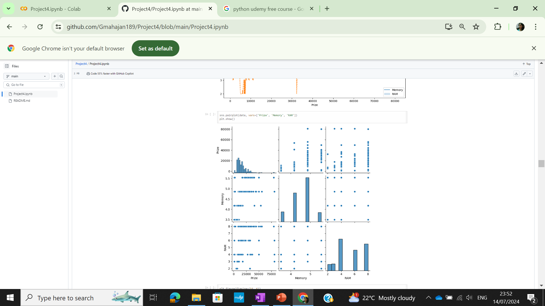
Solution
Lineplot to see Memory and RAM Trend with Prize
Pairplot to visualize relationship between the variables

Slide 17
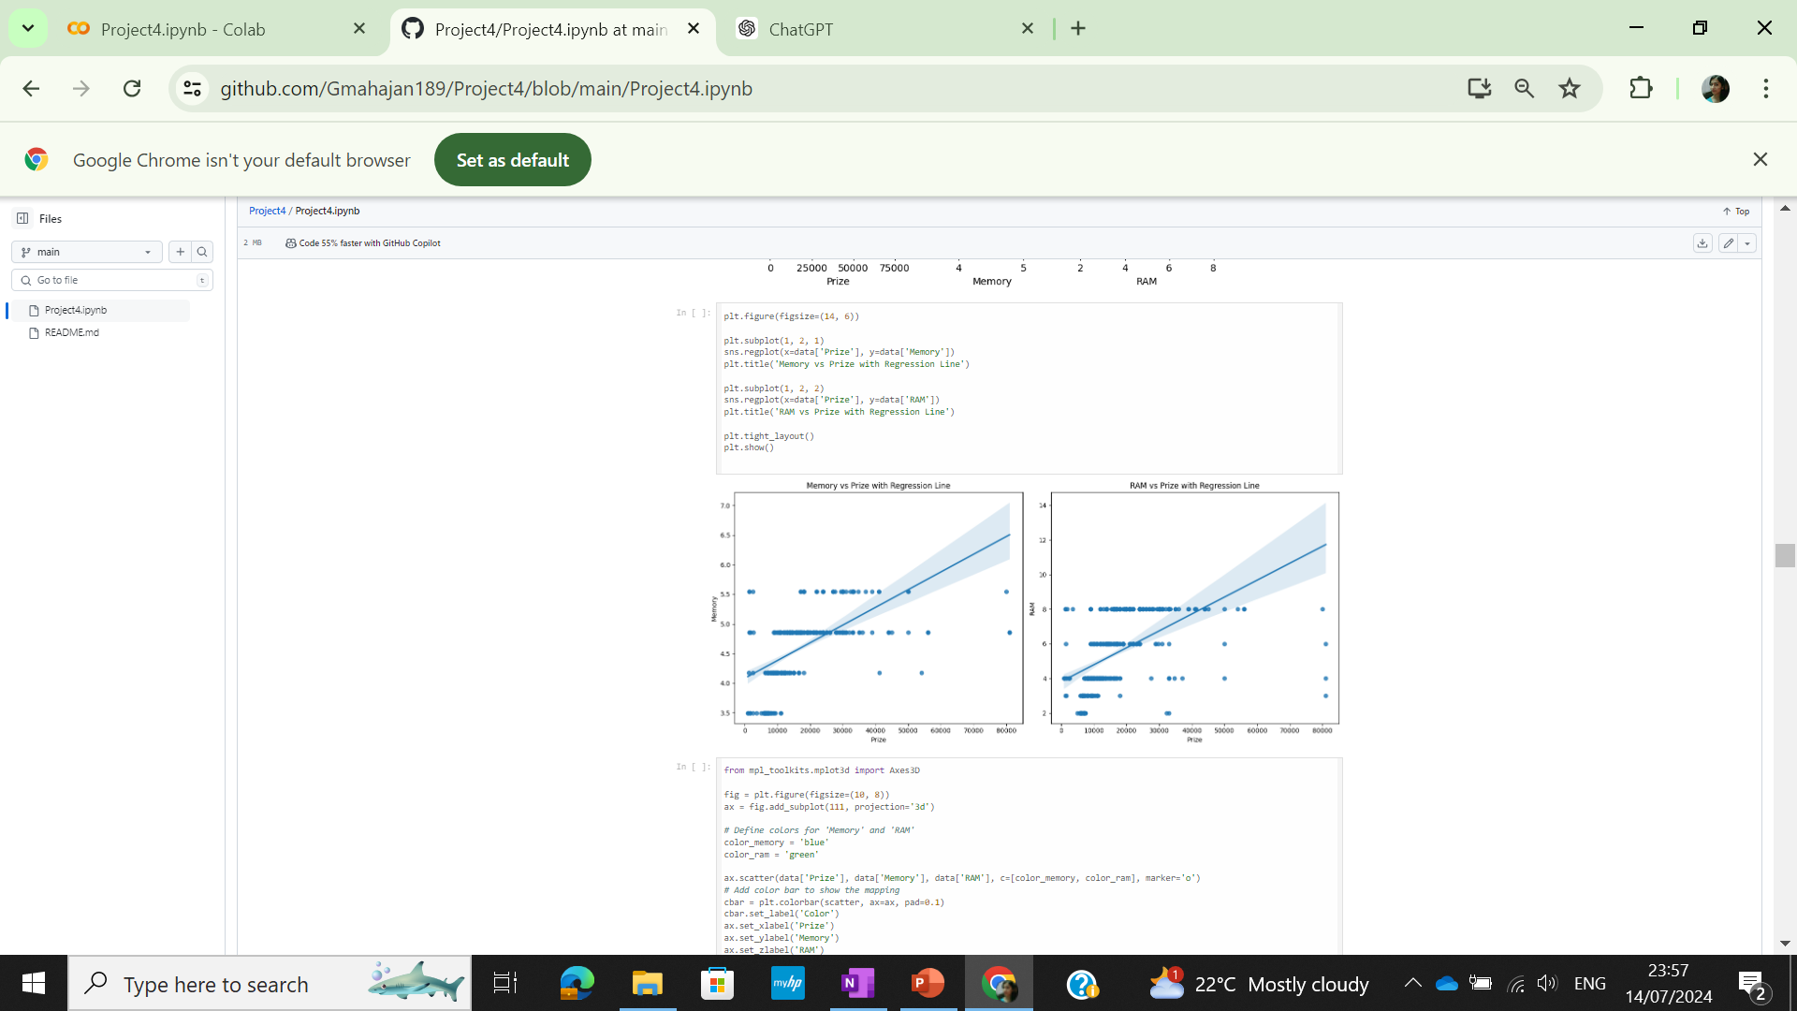
Solution
Scatterplot with regression line to understand the correlation between prize, memory and prize,RAM

Slide 18
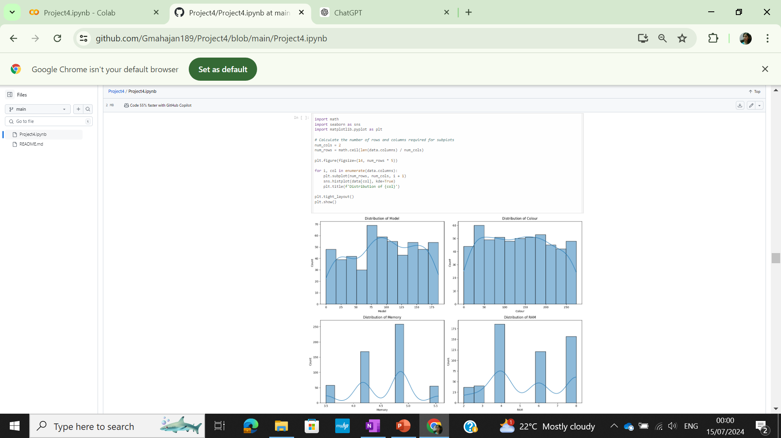
Solution
Distribution for all features visualized using Histograms

Slide 19
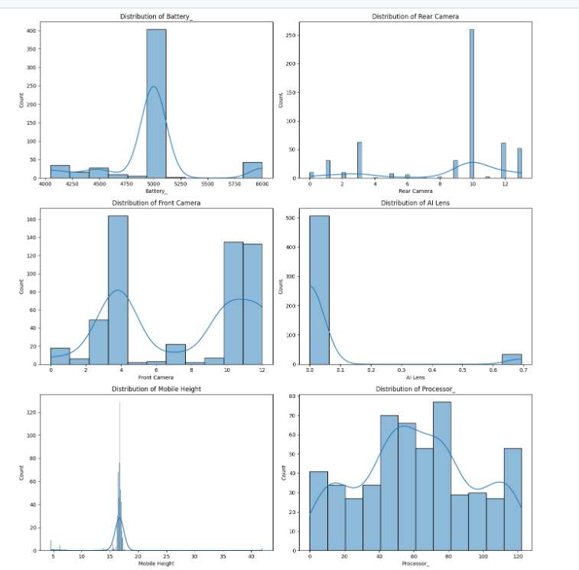
Solution
Distribution for all features visualized using Histograms

Slide 20
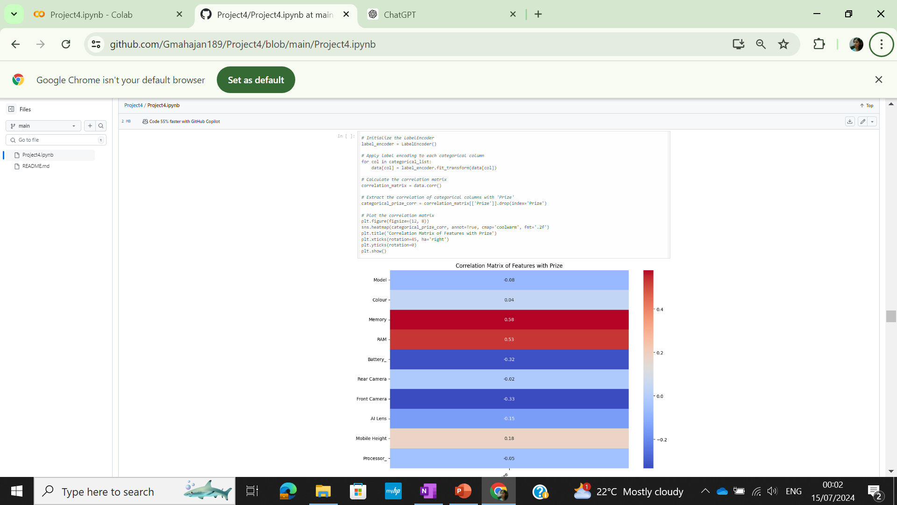
Solution
Heatmap plotted for correlation matrix and correlation of all features with prize checked . Memory,RAM have the highest positive correlation with prize

Slide 21
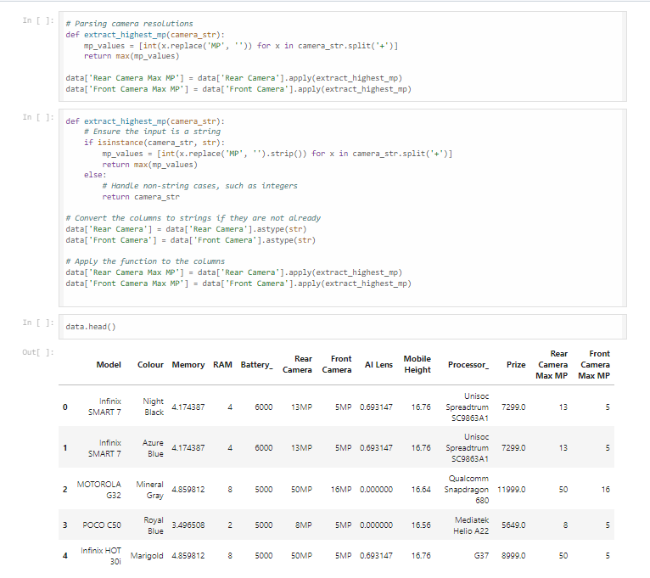
New Features Generation
New Features were generated using the def function- Rear Camera Max MP and Front Camera Max MP and introduced into dataset

Slide 22
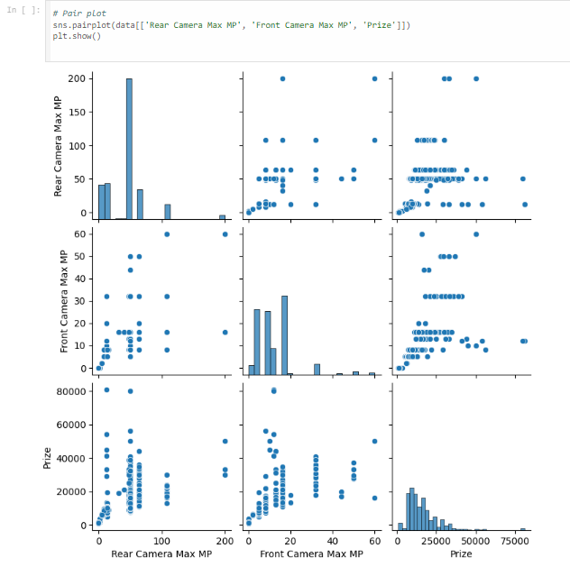
EDA Plots
Pair plot that includes scatter plots and histograms to visualize the relationships and distributions among three variables: Rear Camera Max MP, Front Camera Max MP, and Prize.

Slide 23

EDA Plots
Box-Plot between to visualize prize distribution with Rear camera Max MP and Front camera Max MP

Slide 24

Modelling
Dataset splitted into Training and Test data
Target column(Y) set as Prize and dropped from X. Model chosen as Linear Regression as the target Prize is Continuous variable
MAE,MSE,R-squared imported as these are the performance metrics for a Regression Problem
Performance metrics evaluated for the Linear Regresssion model to assess model performance

Slide 25
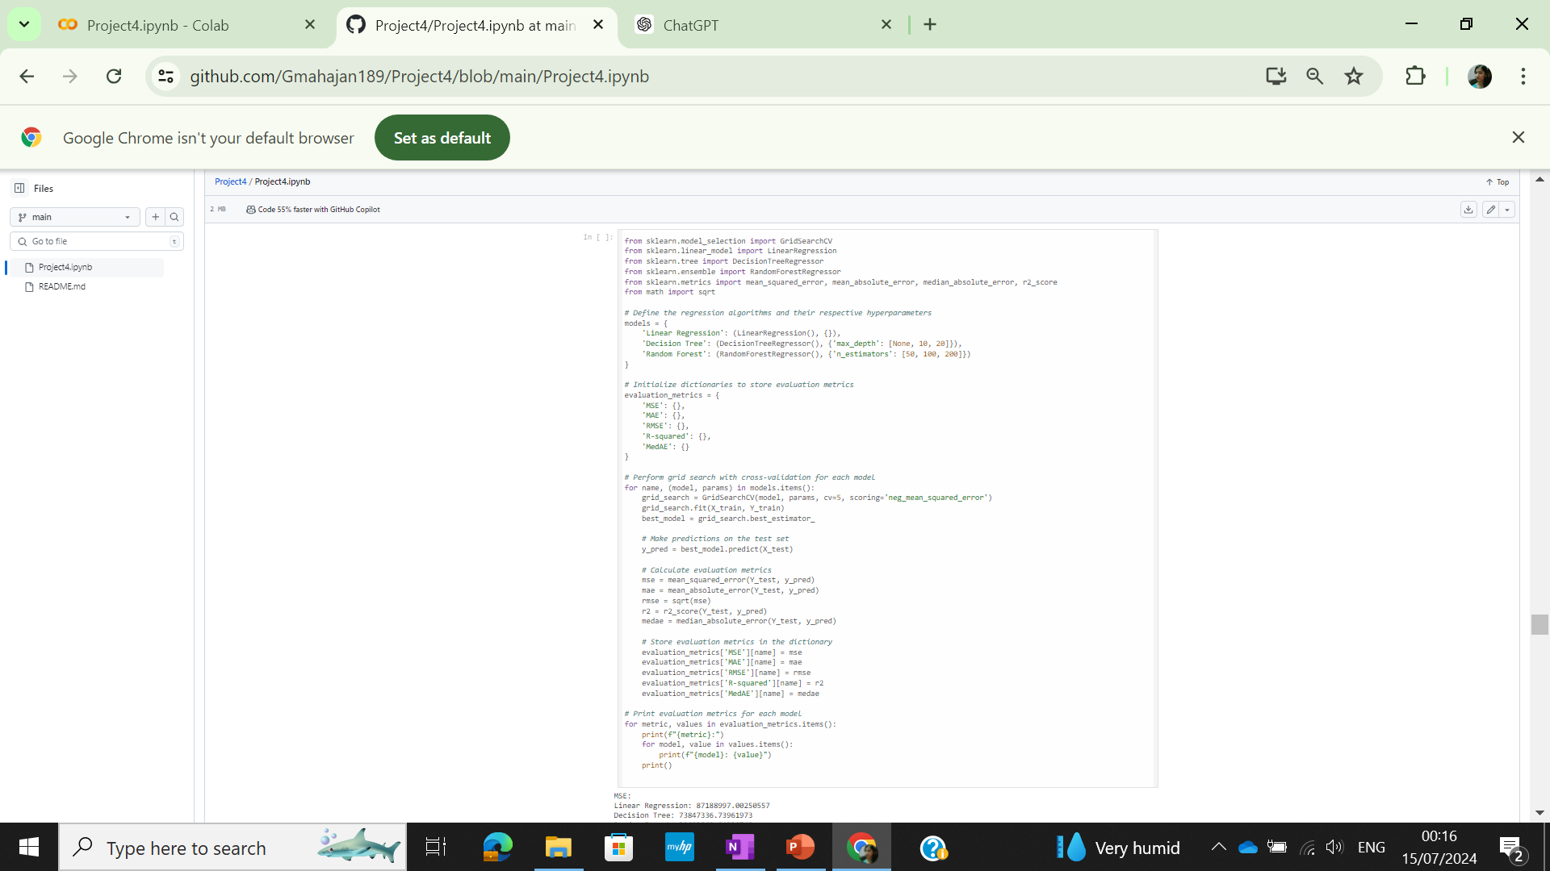
Modelling
Linear Regession,Decision Tree, Random Forest Regressor models imported
Hyperparameters defined for Decision Tree and Random Forest Regressor models
For performing a grid search with cross-validation to find the best hyperparameters for each model in a set of models
Performance metrics evaluated for the all the models

Slide 26
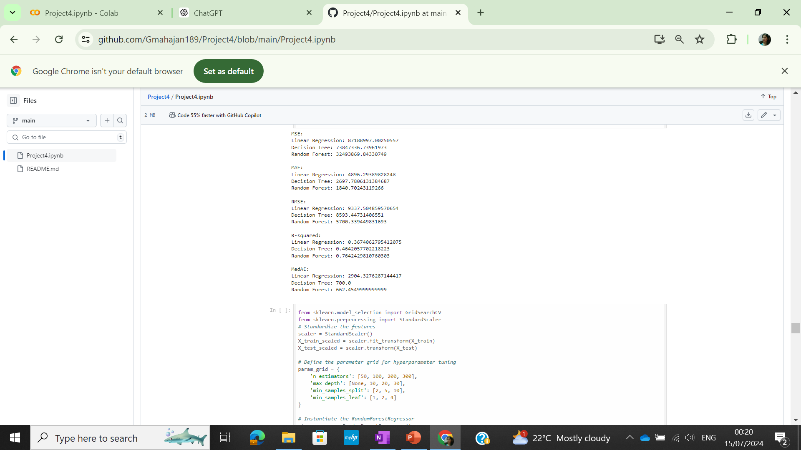
Modelling
Modelling results indicate RandomForest as the best model due to lowest MAE,MSE implying less error and Highest R-Squared amongst model meaning the best fit
For performing a grid search with cross-validation to find the best hyperparameters for each model in a set of models

Slide 27
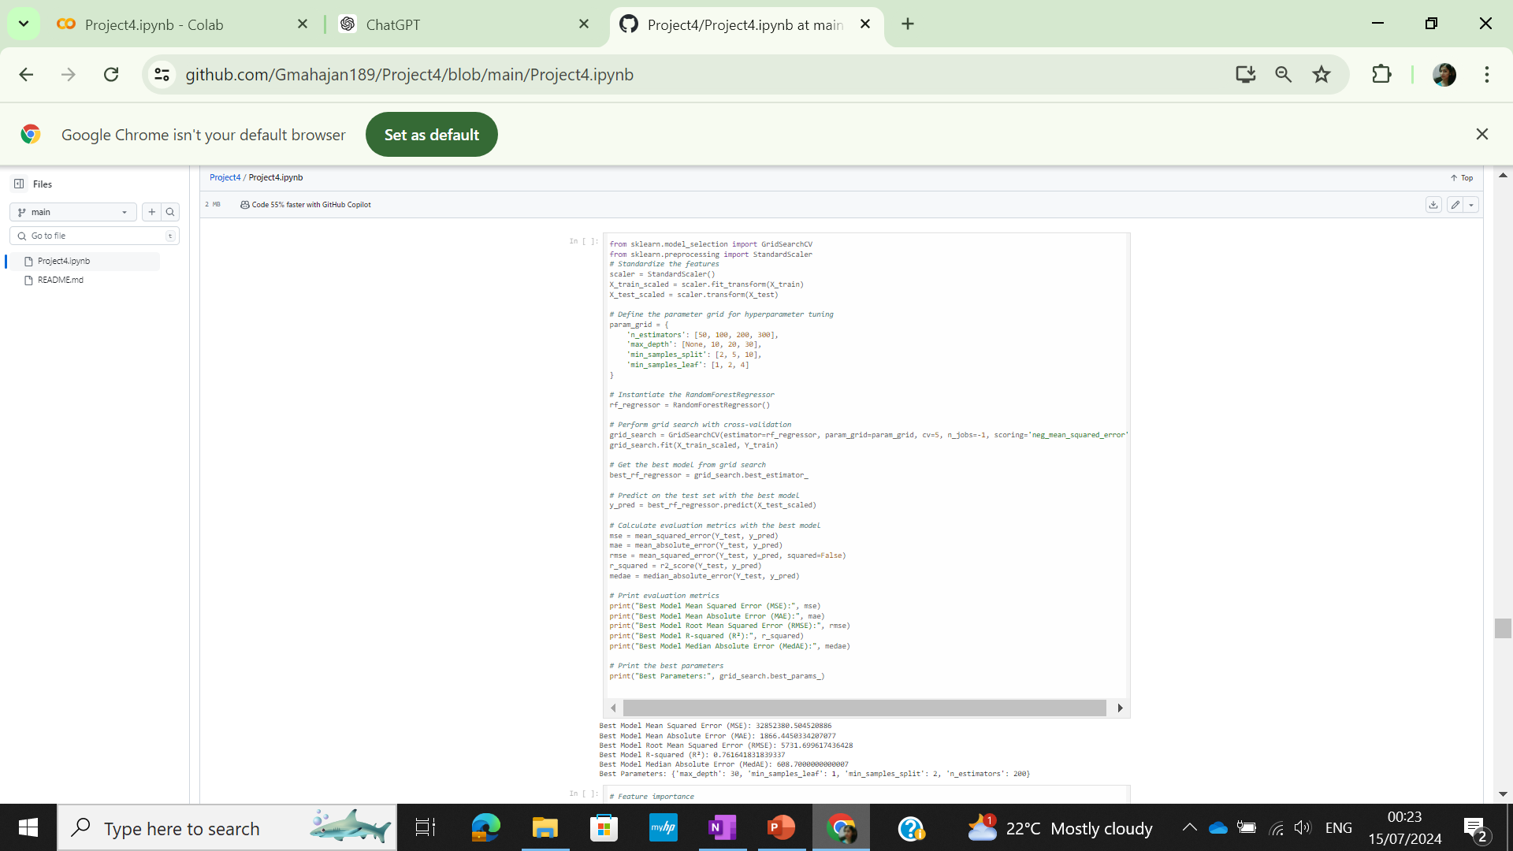
Modelling
Hyperparameter tuning for RandomForest Regressor to find the Hyperparameters for the best fit
For performing a grid search with cross-validation to find the best hyperparameters
Performance metrics evaluated for the hyperparameters combination giving the best fit

Slide 28
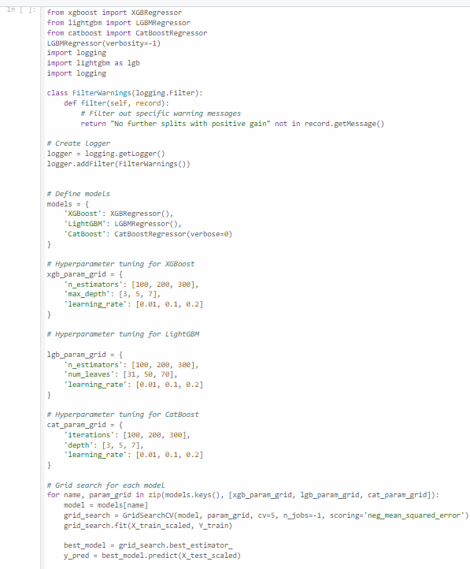
Ensemble Methods for Modelling
XGBRegressor from xgboost, LGBMRegressor from lightgbm, and CatBoostRegressor from catboost are imported for building the regression models.
Logging for logging manual messgaes
A dictionary models is defined with keys as model names and values as instances of the corresponding model objects.
GridSearchCV is instantiated with the model, parameter grid, 5-fold cross-validation (cv=5), and the scoring metric (neg_mean_squared_error).

Slide 29
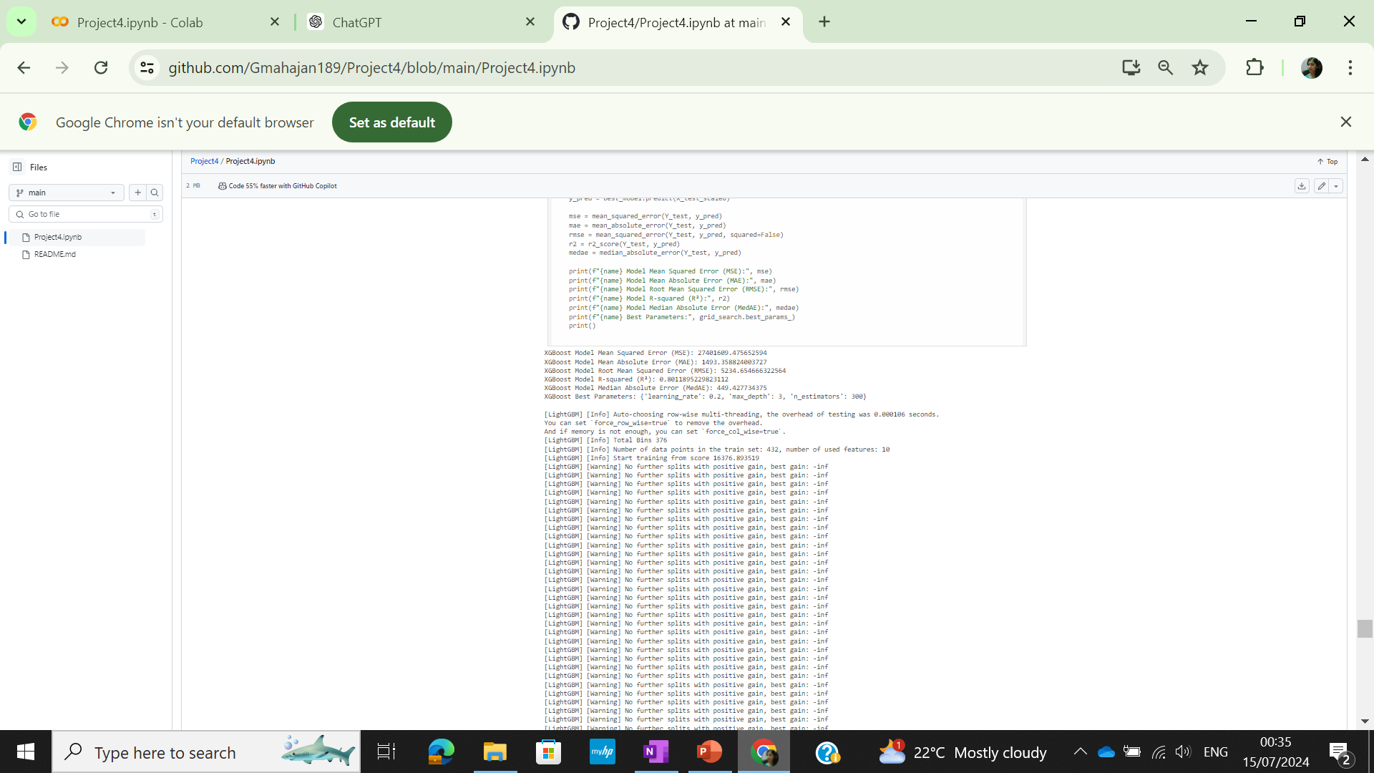
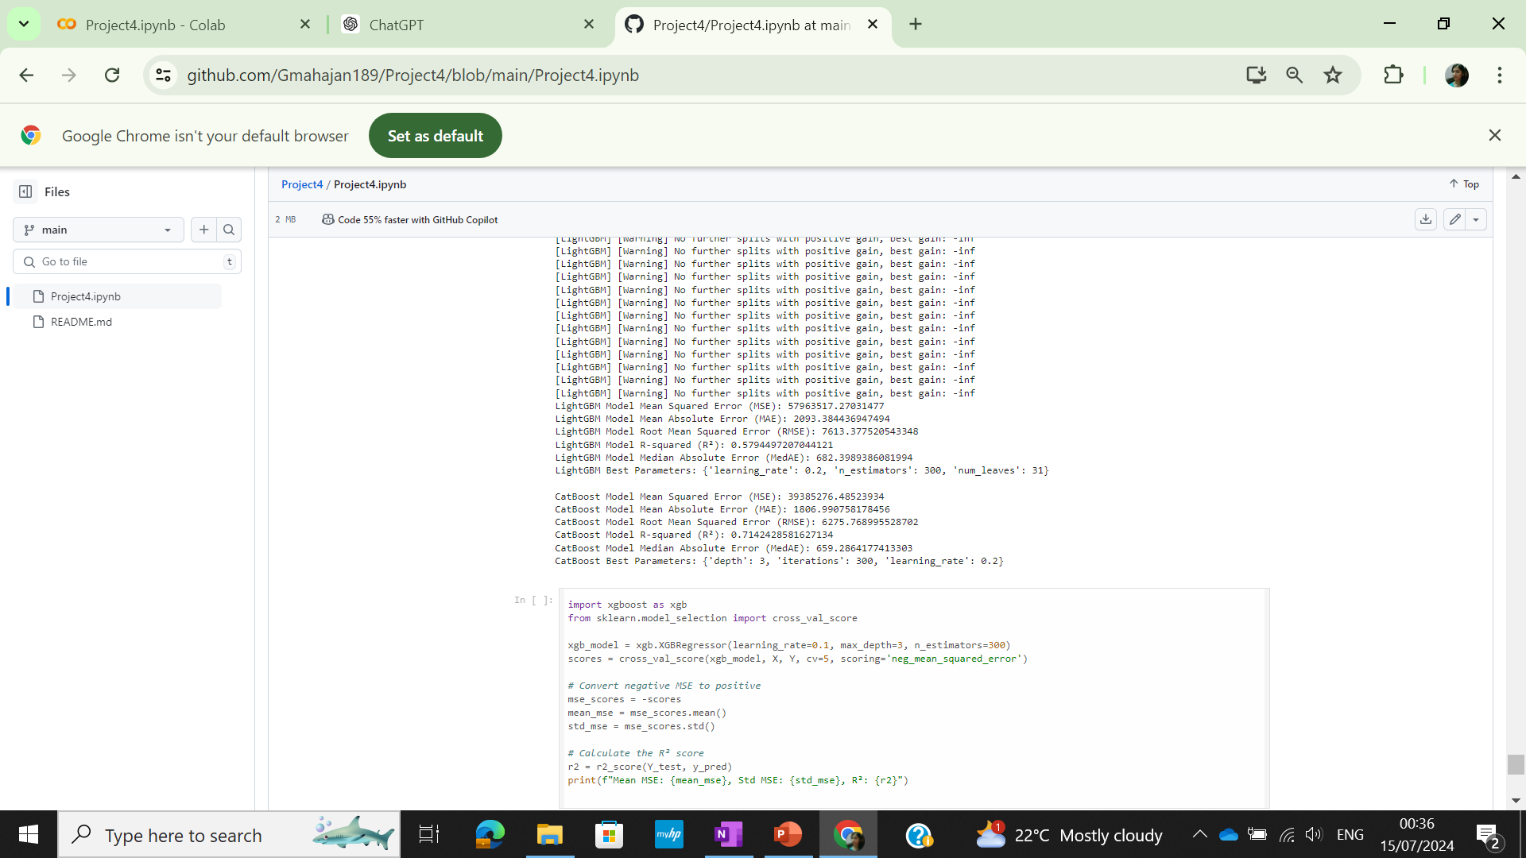
Ensemble Methods for Modelling
XGBoost model gives the lowest MAE,MSE and highest R-Squared indicating the best fit with lowest errors amongst the models

Slide 30
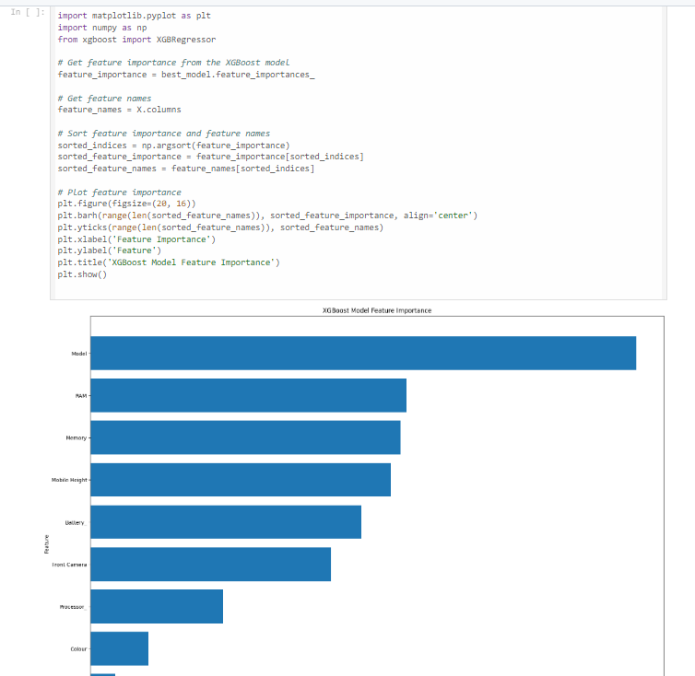
Ensemble Methods for Modelling
Feature Importance for XGBoost model barplot made indicating that Model and RAM are the most important features

Slide 31
Modelling results
Based on the performance metrics , it's evident that the XGBOOST model outperforms the Linear Regression, RANDOM FOREST and Decision Tree models across multiple metrics, including lower Mean Squared Error (MSE), Mean Absolute Error (MAE), Root Mean Squared Error (RMSE), and higher R-squared value.
This suggests that the XGBOOST model provides a better fit and higher accuracy in predicting the target variable compared to the other models. Therefore, it can be concluded that thIS model is the most effective among the three for PREDICTING THE MOBILE PHONE PRICES

Slide 32
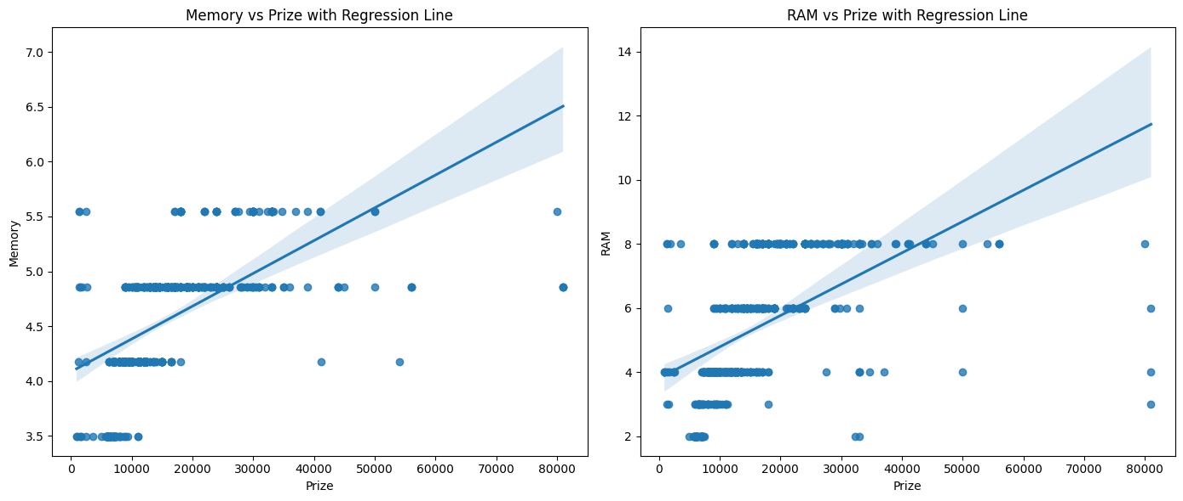
Conclusion
-Both plots suggest that as the price of the product increases, both memory size and RAM tend to increase.
-The confidence intervals suggest that there is some variability in the data, but the overall trend remains positive.
-The positive correlation implies that higher-priced products generally come with larger memory and more RAM.

Slide 33
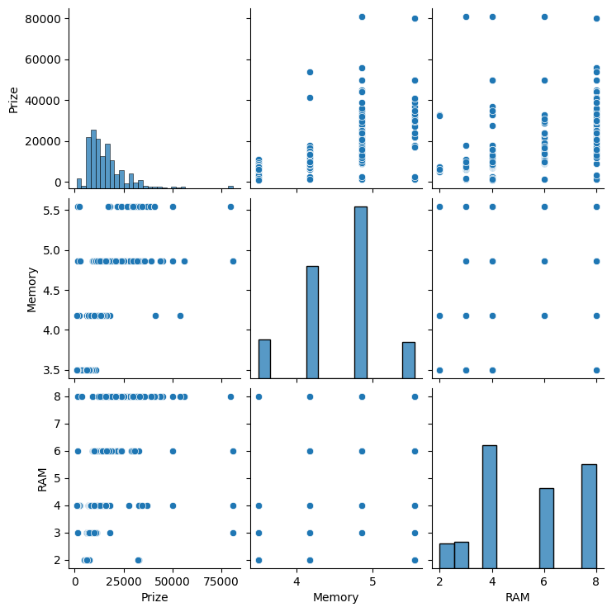
Conclusion
-There is a general trend that higher camera specifications (both rear and front) are associated with higher prizes.
-The data has outliers, especially in the camera specifications.
-The distribution of prizes is heavily skewed towards lower values, suggesting most products are priced lower, with a few high-end products priced significantly higher.

Slide 34
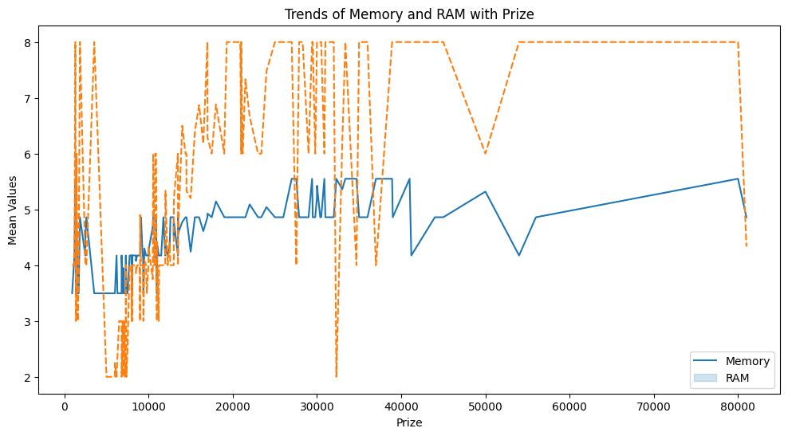
Conclusion
-The plot effectively shows that both memory and RAM increase with the prize, but memory has a more stable upward trend while RAM values are more variable.
-Understanding these trends can help in analyzing how prize impacts the specifications of products, particularly in terms of memory and RAM.

Slide 35
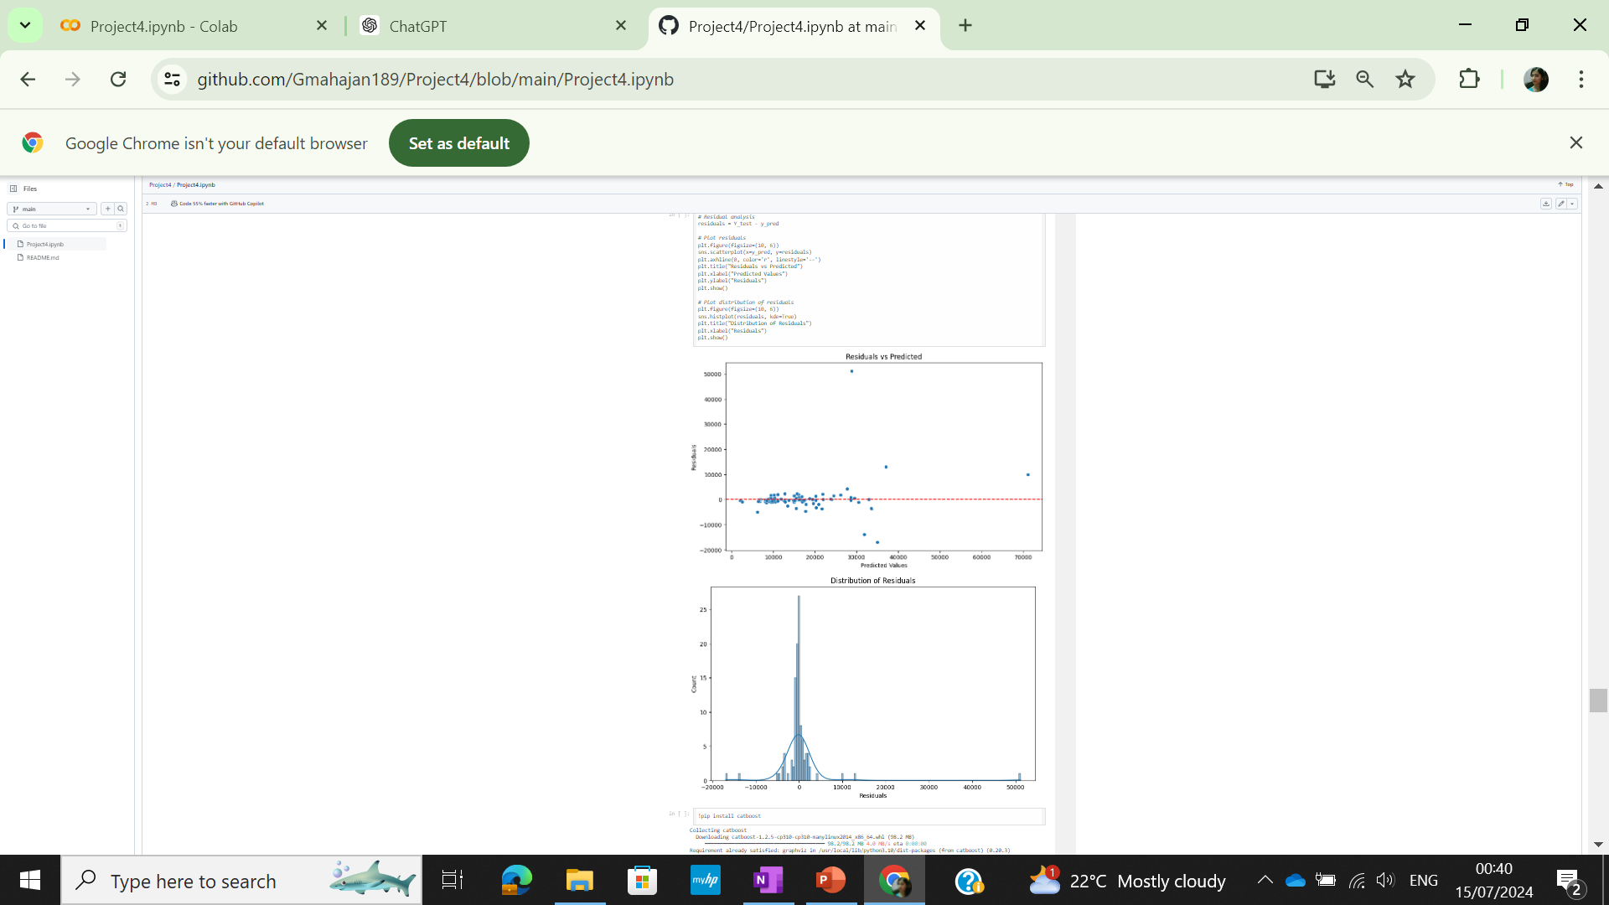
Modelling Results
Uniform distribution of residuals around zero indicates balanced errors across predicted values, ensuring the model isn't consistently over- or under-predicting.
Even spread of residuals reflects a well-fitted model, capturing data patterns effectively and providing reliable predictions.

Slide 36
THANK YOU!

